Slide 1
Bioinformatics
Setup

Slide 2
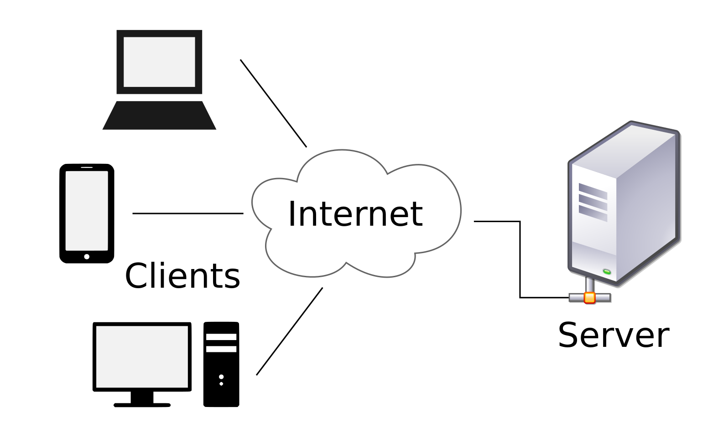
Networks
You can connect to a remote server via the internet
A secure server will ask for a username/password and may restrict access based on your network location
To connect to ETH servers you need to use the VPN

Slide 3
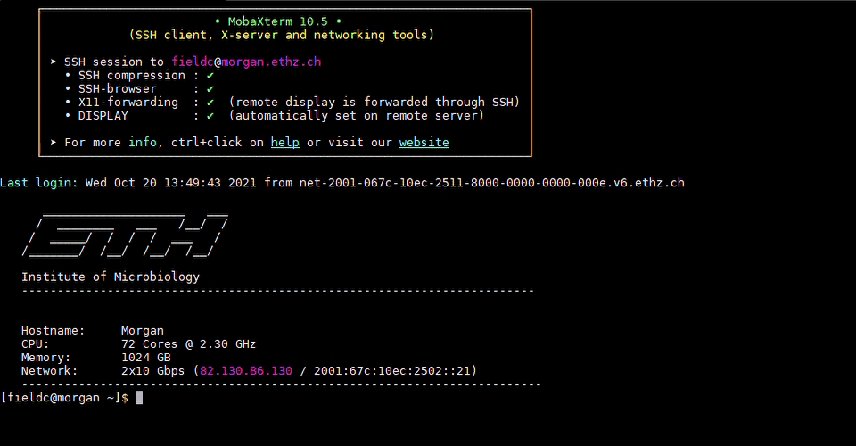
Command Line Interface

Slide 4
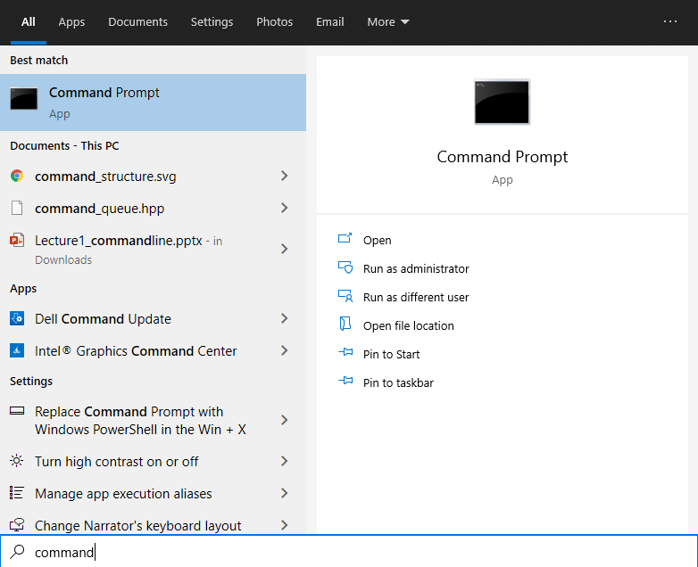
Command Line Interface (Windows)
Access through the Windows menu by searching for command
Or Windows Key + R, type in cmd and press enter

Slide 5
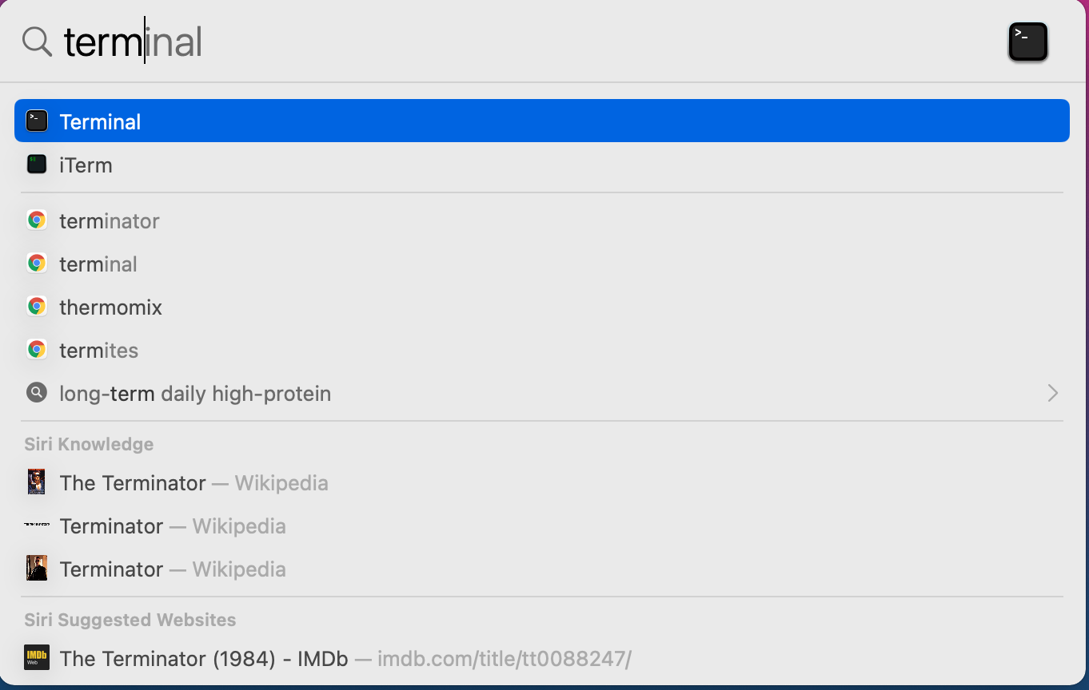
Command Line Interface (Mac)
Click the Launchpad icon in the Dock, type Terminal in the search field, then click Terminal
Alternatively in the Finder, navigate to the /Applications/Utilities folder and launch Terminal from there

Slide 6
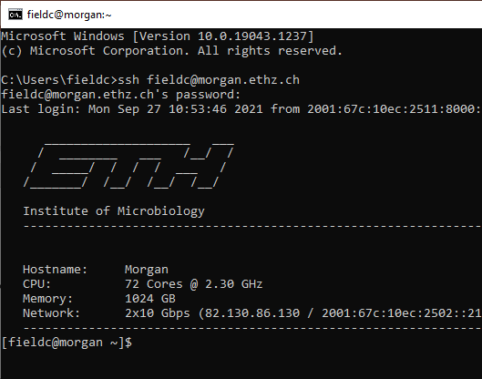
Connecting to a remote server with SSH
Computers talk to each other via communication protocols
For instance, your internet browser uses HTTP, your email IMAP or POP
Secure SHell is an encrypted protocol for remote access

Slide 7
R Workbench
Web-based platform for our programming needs
https://rstudio-teaching.ethz.ch/
Supports R, Unix, Python and more

Slide 8
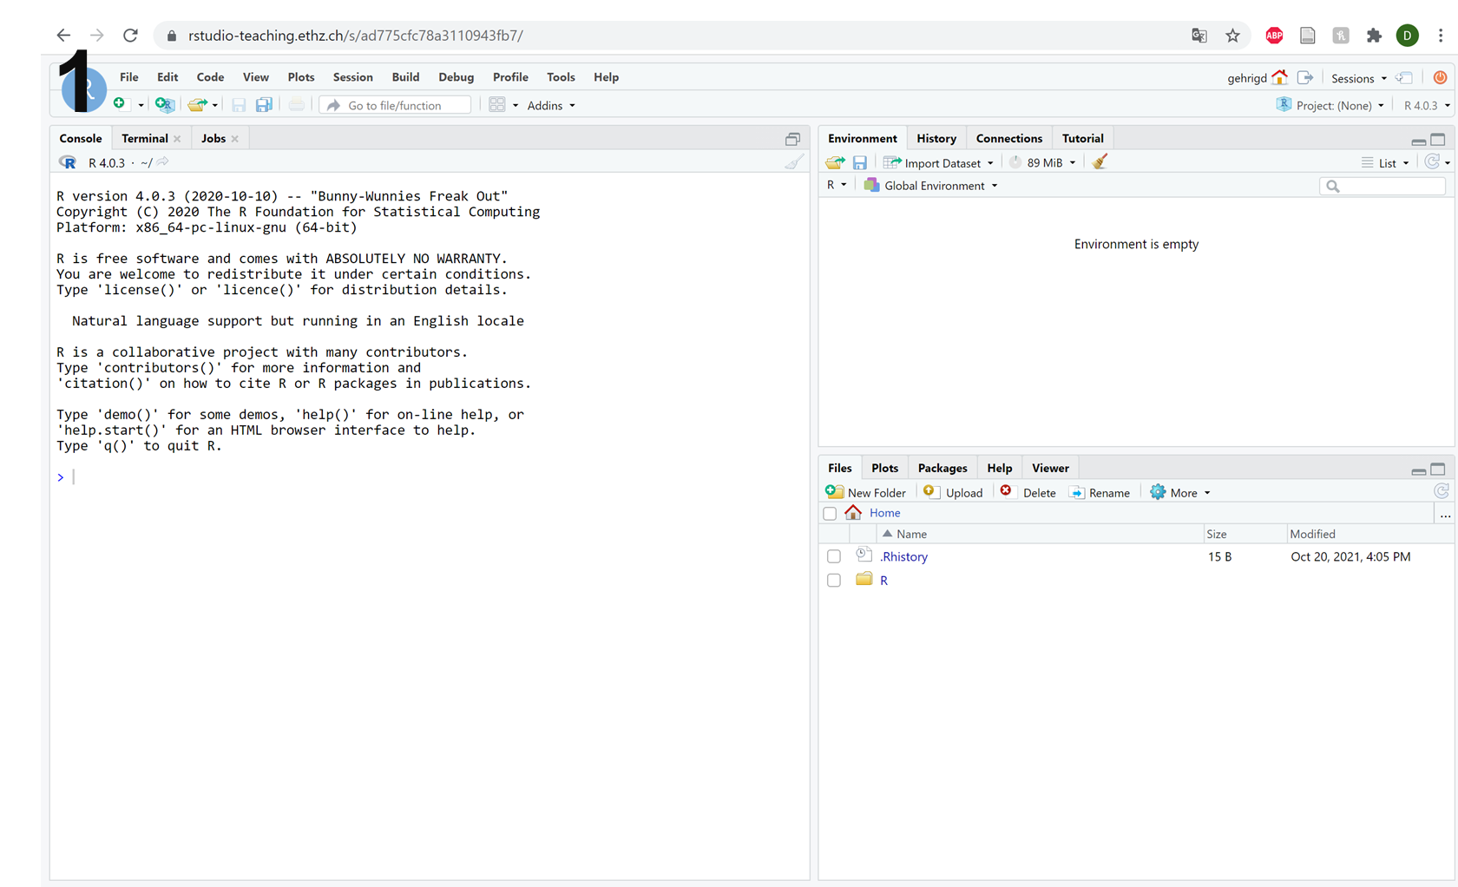
R Workbench: R

Slide 9
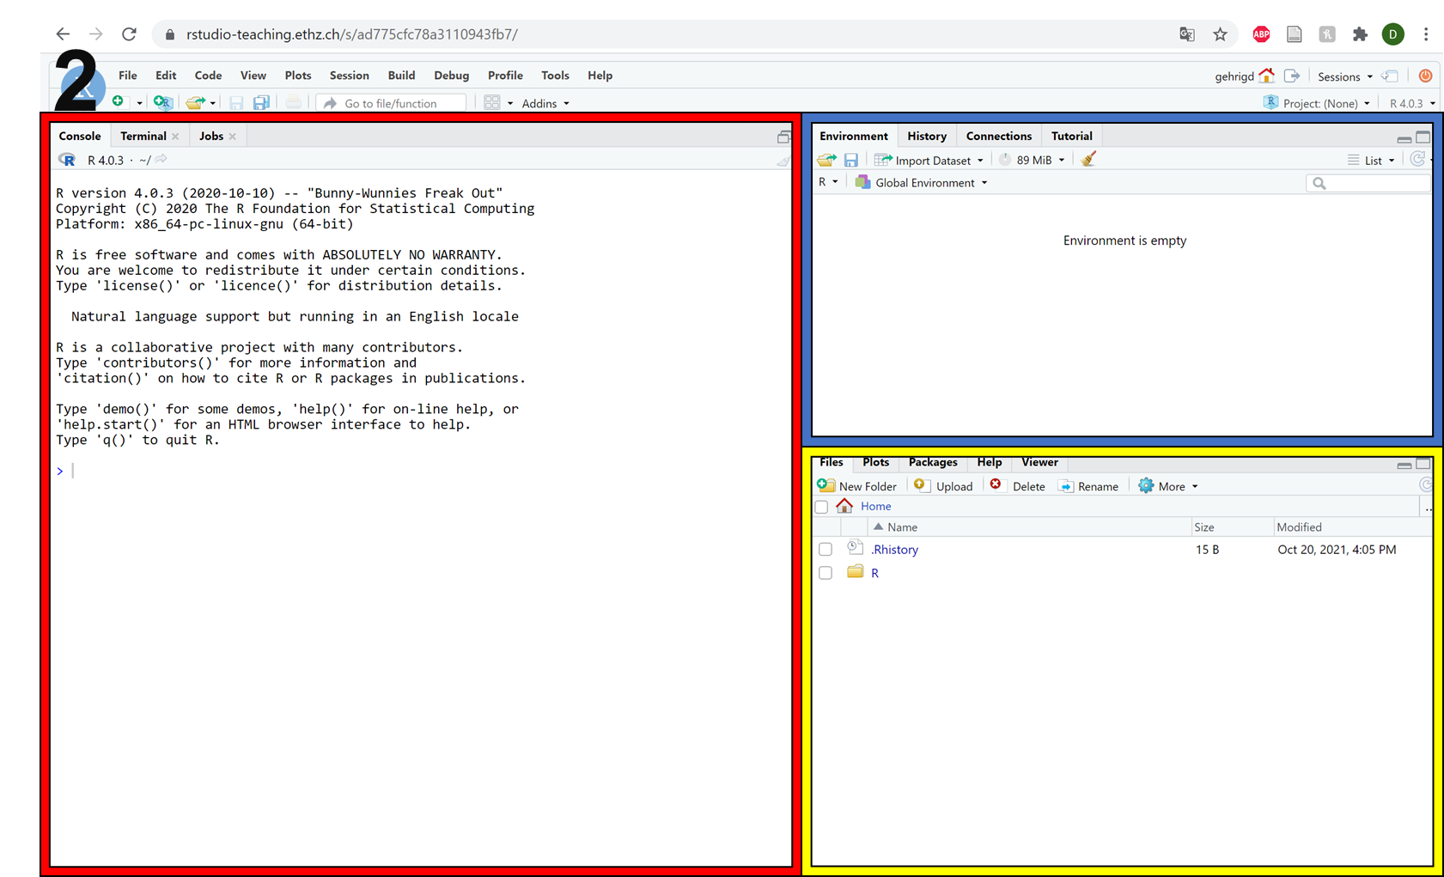
R Workbench: R
Variables
R Console
File Browser
Plots
Packages
Help

Slide 10
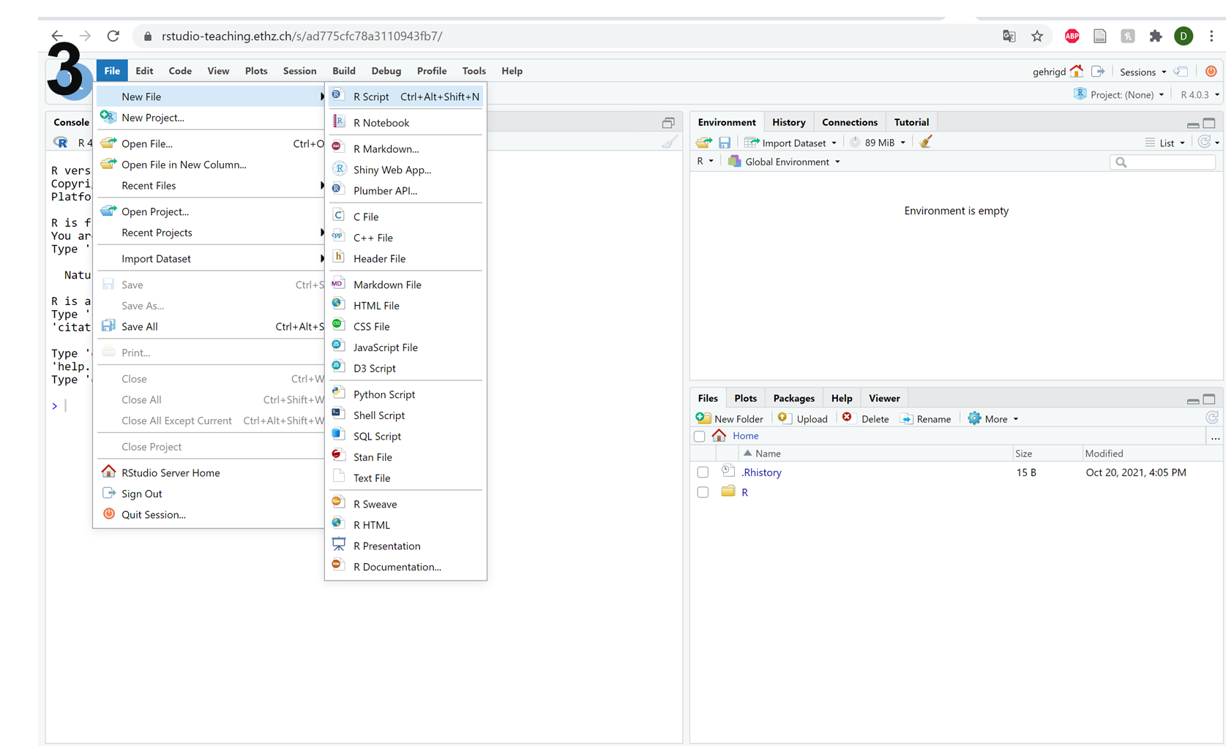
R Workbench: new R script

Slide 11
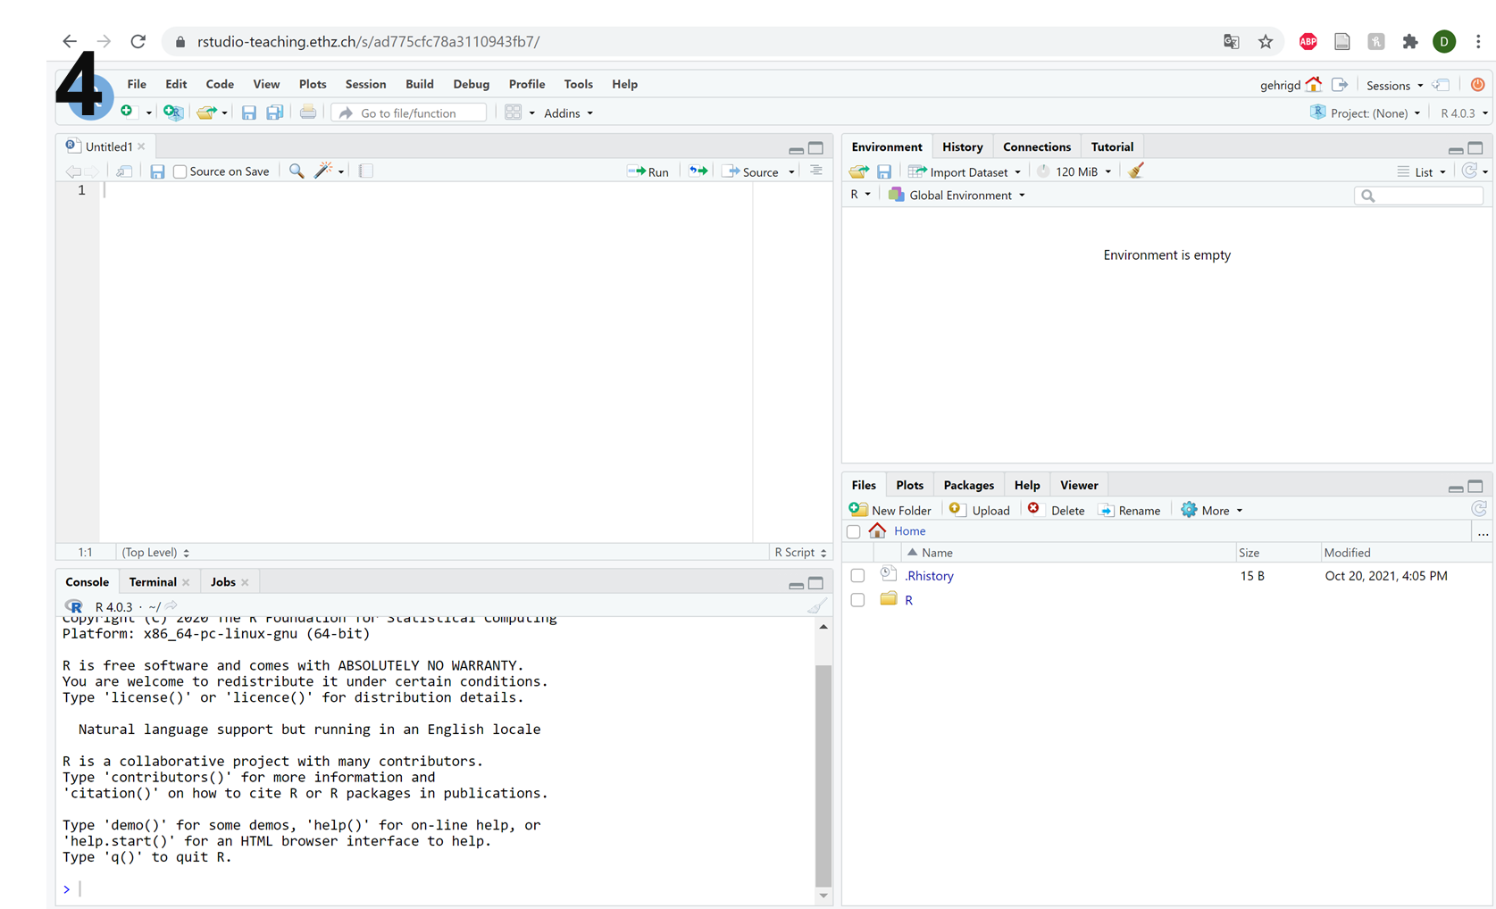
R Workbench: new R script

Slide 12
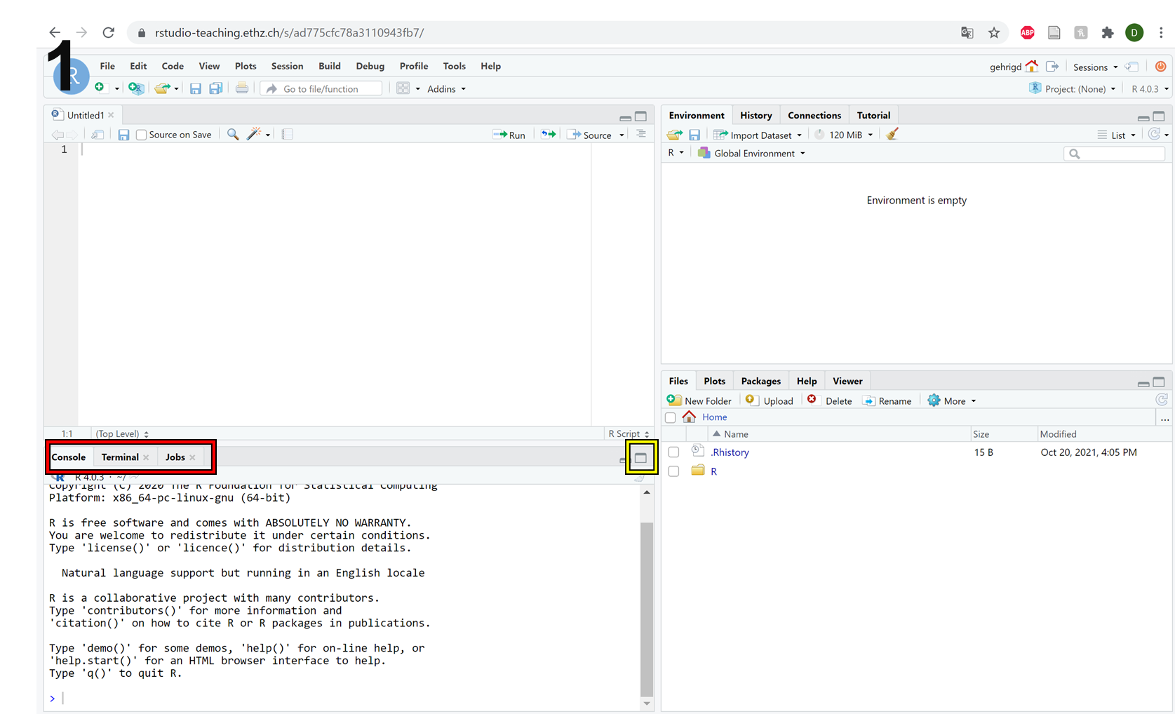
R Workbench: Terminal

Slide 13
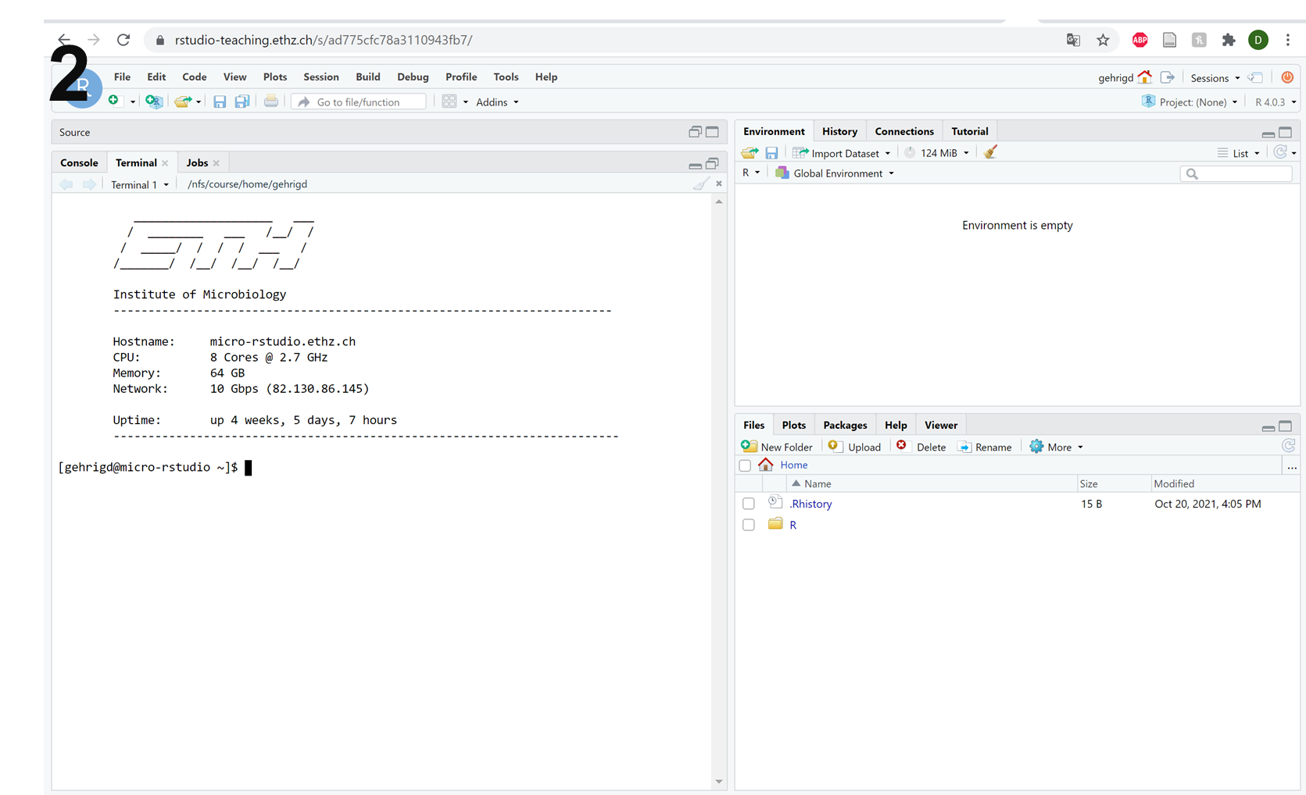
R Workbench: Terminal

Slide 14
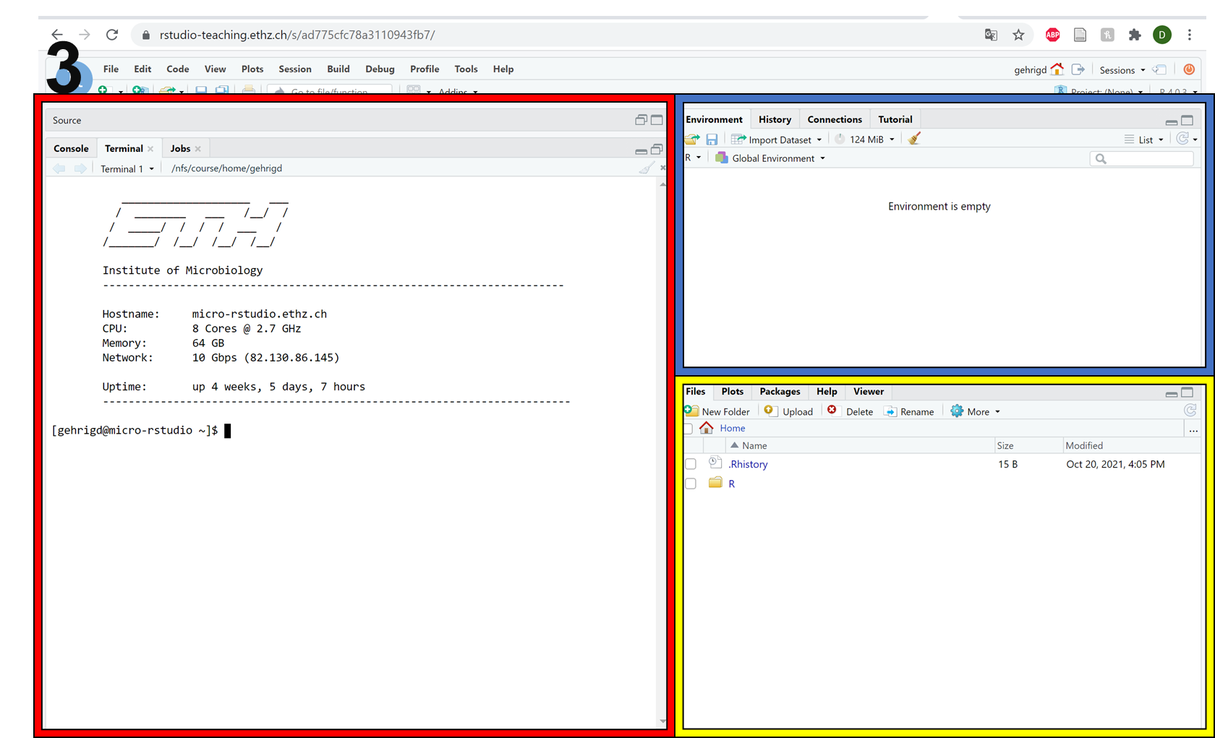
R Workbench: Terminal
Not used
Terminal
File Browser

Slide 15
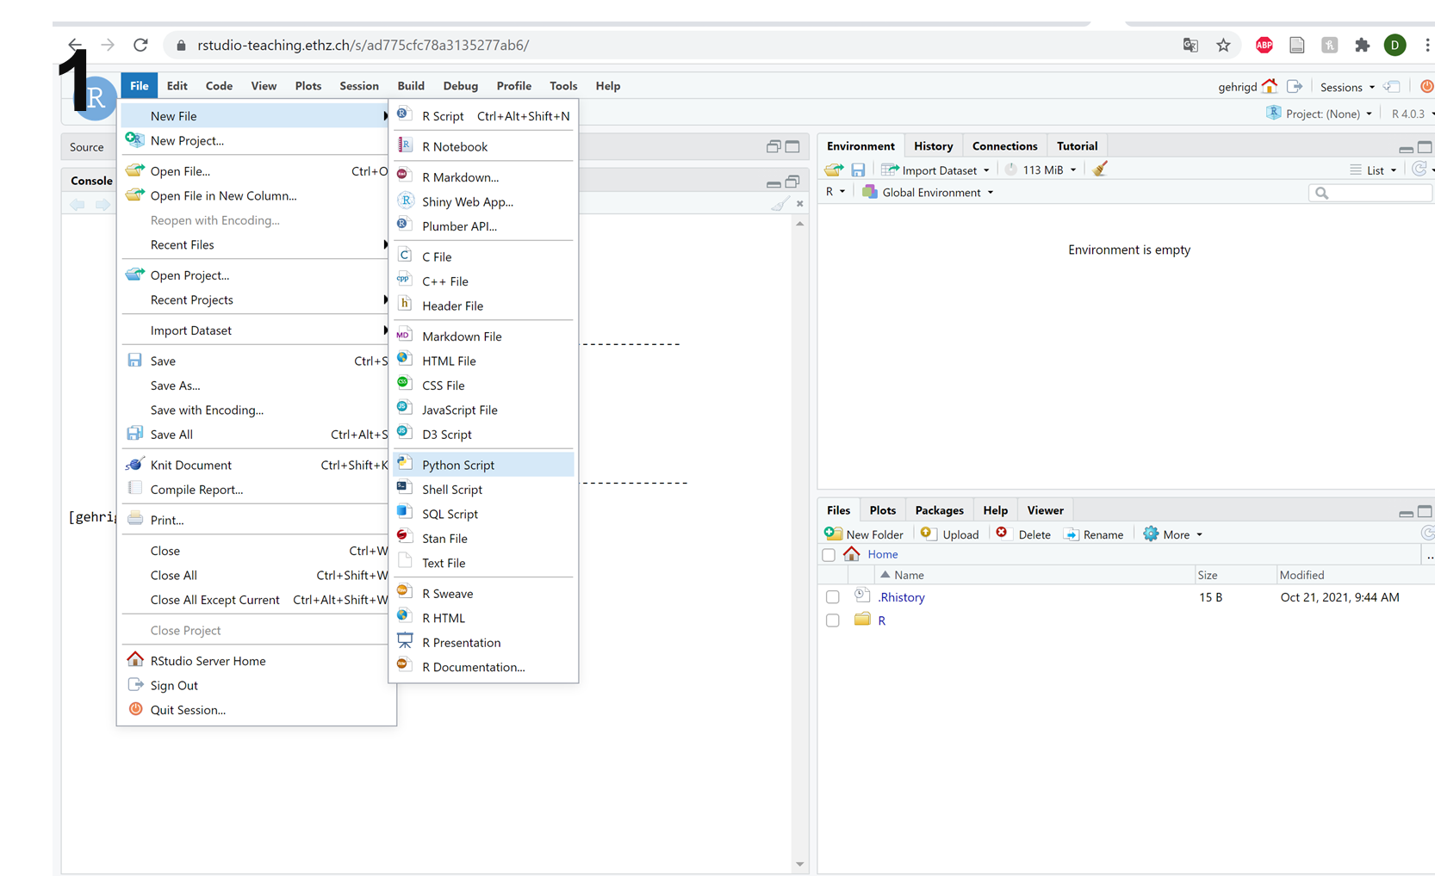
R Workbench: new Python script

Slide 16
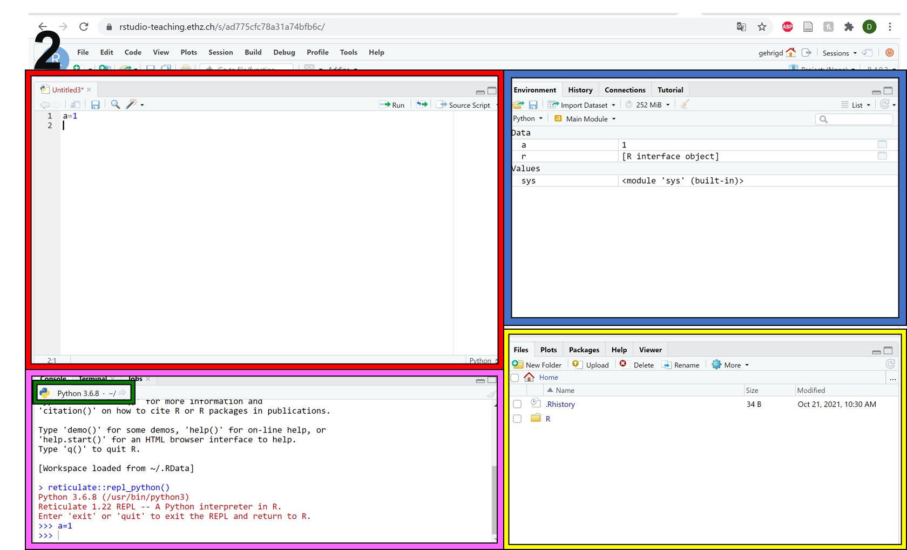
R Workbench: Python
Variables
Script
File Browser
Python Console

Slide 17
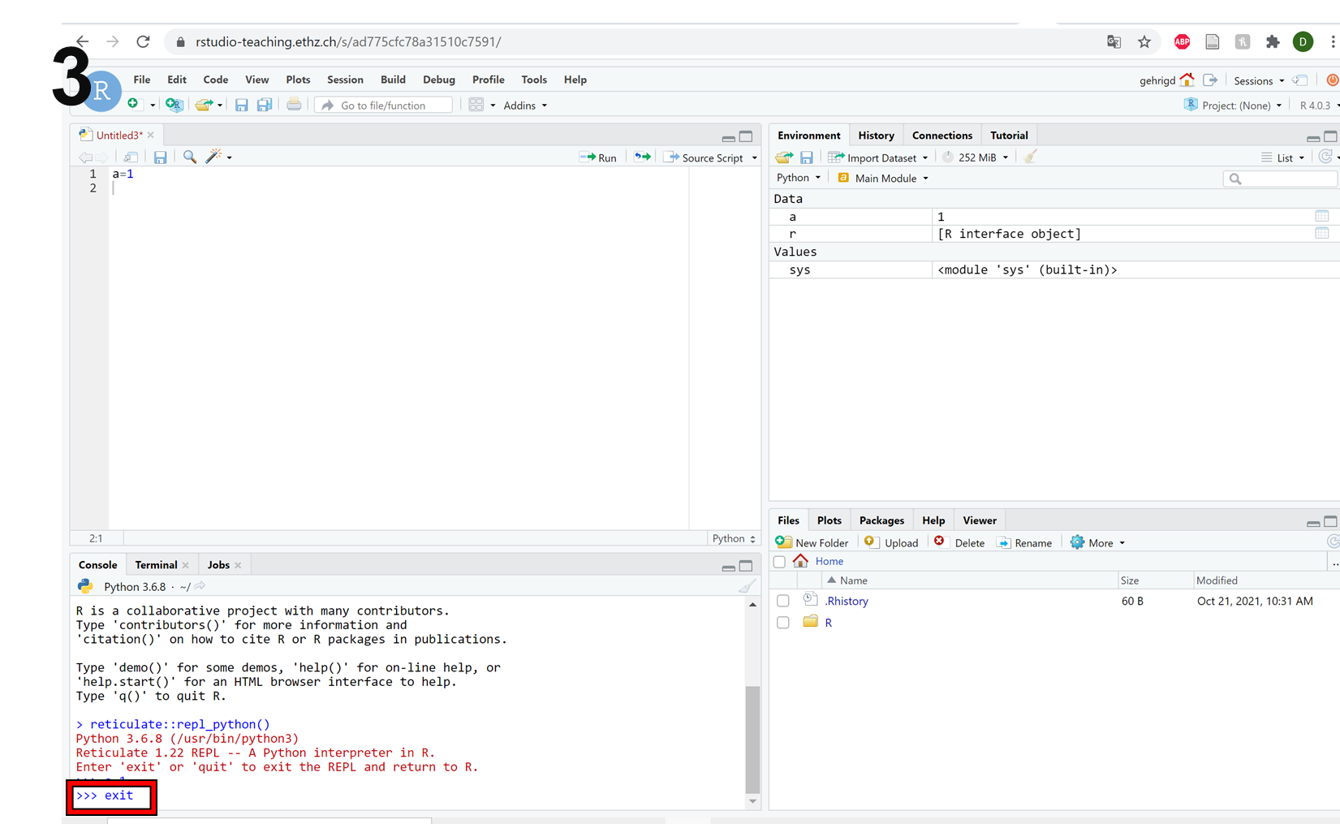
R Workbench: Leaving Python

