Slide 1
The study of gut microbiota using the 16S rRNA gene
Shinichi Sunagawa / Guillem Salazar, Sep 17th 2019

Slide 2
Overview
Studying microbiota by 16S rRNA gene analysis
Human gut microbiome in health and disease
Diet effect on microbiome – introduction of work during next days

Slide 3
Terminology
Individual – organism of specific genotype (e.g., bacterial strain)
Microbial ‘species’ – a group of co-existing strains that display greater genotypic similarity within themselves than to strains in other groups; often operationally defined based on sequence similarity of taxonomic marker genes (e.g. 97% 16S rRNA gene): → OTU - operational taxonomic unit
Microbiota – microbial taxa that populate a given habitat (e.g. gut microbiota)
→ Taxonomic marker genes
Microbiome – microbial taxa and their genomic content (e.g. gut microbiome)
→ Metagenomics

Slide 4
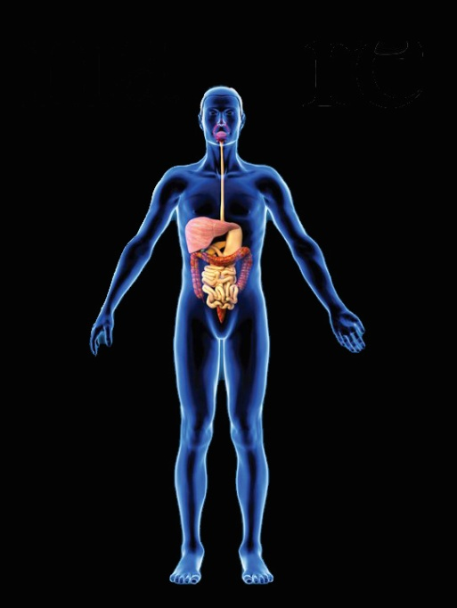
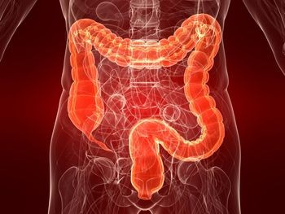
Metagenomics analysis
DNA sample
Assembly
Predicted genes / genomes
sequencing
reconstruct genomes
human, ocean,
soil, air, etc.
Raw reads
HQ reads
Reference gene catalog
Taxonomic marker genes
Quantitative analyses
Taxonomic marker genes
‘Who is there?’
- species composition
- community structure
Taxonomic profiles
HQ reads
Reference gene catalog
‘What do they do?’
- functional potential
Gene functional profiles
Reference genomes
‘How do variable are individuals?’
- gene content differences
‘How are populations structured?’
- biogeography of individual species
Genomic variations
Kultima, et al., PLoS One 2012 & Bioinformatics 2016; Sunagawa, et al., Nature Meth, 2013;
Mende, Sunagawa, et al., Nature Meth, 2013; Schloissnig, et al., Nature, 2013; Nielsen, et al., NBT, 2014; Li, et al., NBT, 2014

Slide 5
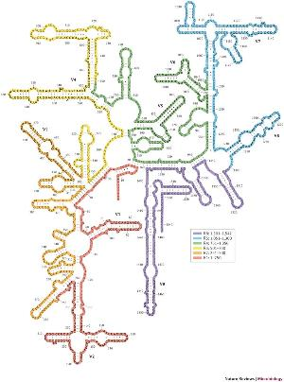
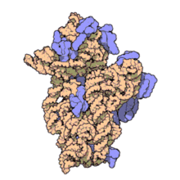
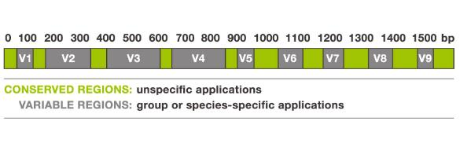
The 16S rRNA gene
Part of prokaryotic ribosomes
16S rRNA present in all prokaryotes
conserved regions and variable regions
Secondary structure of 16S rRNA
50S large subunit (33 proteins) | 5S: 120 nt 23S : 2906 nt
30S small subunit (22 proteins) | 16S: 1542 nt
30S small subunit
blue: ribosomal proteins
gold: 16S rRNA

Slide 6
Popular 16S rRNA gene databases
https://rdp.cme.msu.edu/
University of Michigan
http://greengenes.lbl.gov
LBNL Berkeley,
now second genomes
https://www.arb-silva.de/
Technical University Munich,
now MPI Bremen
Taxonomy: Kingdom, Phylum, Class, Order, Family, Genus, Species, (Strain)
But…NCBI, Bergey, SILVA, Greengenes, …

Slide 7
Popular 16S rRNA gene analysis tools
Mothur
https://www.mothur.org/
University of Michigan
USERCH/UPARSE
http://www.drive5.com/usearch/
Robert Edgar
QIIME
http://qiime.org/
University of Colorado

Slide 8
Community structure analysis
Relative abundances
note: suffers from
problem of compositionality
Alpha-diversity
ecologically defined as
a function of the number of
species (richness) and the
evenness of species distribution
Beta-diversity
analysis of between-
community dissimilarity

Slide 9
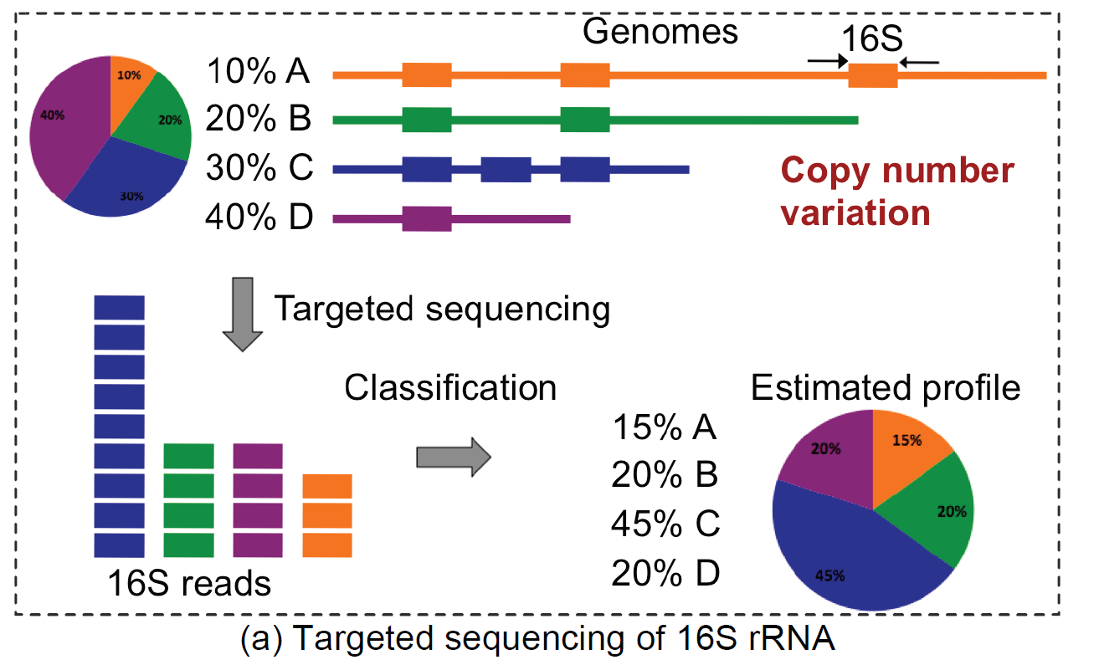
Caveat of multiple 16S rRNA gene copies
See also: https://rrndb.umms.med.umich.edu/

Slide 10
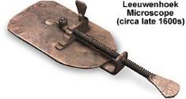
The human microbiome
Antonie van Leewenhoek (microscope → microbiology) studied differences between oral and fecal ‘animalcules’ in 1680s
Term “microbiome” coined in 2001 by Joshua Lederberg
What is it to be human?
What is the microbiome?
Largest population resides in gastrointestinal tract: the gut microbiome
“How many gut microbial species exist?” (problems with definitions of bacterial species)
“How does the gut microbiome vary over time and between individuals?”
“How does the gut microbiome of different sites in the same person compare to the those in other people?”

Slide 11
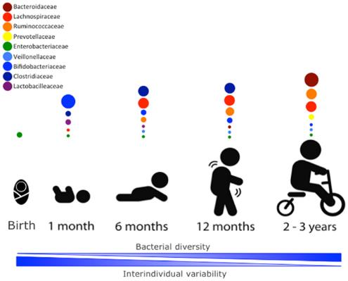
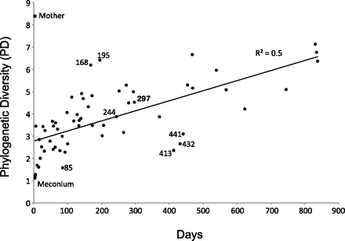
Development of the gut human microbiome
Role of birth mode, diet change, antibiotics treatment
➔ alpha-diversity increases
➔ beta-diversity decresaes
Koenig et al., PNAS, 2010; Arrieta et al., Front. Immunol. 2014

Slide 12
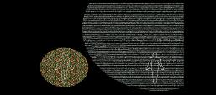
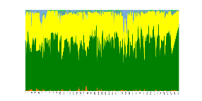
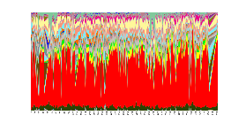
Human gut microbiome in numbers and time
Outnumber human genetic variation
Human
10%
Microbes
90%
Vast majority in gut
100’s (metagenomics) to 1000’s (16S) of OTUs
3 - 10 mio genes (while only ~300k prevalent)
10 mio SNVs in 100 species in 200 individuals
now revised to about 1:1
(Sender et al, 2016)
Temporal variability depends on taxonomic resolution
>1yr daily stool sample sequencing
Phylum-level
OTU-level
Caporaso et al., Genome Biol, 2011

Slide 13
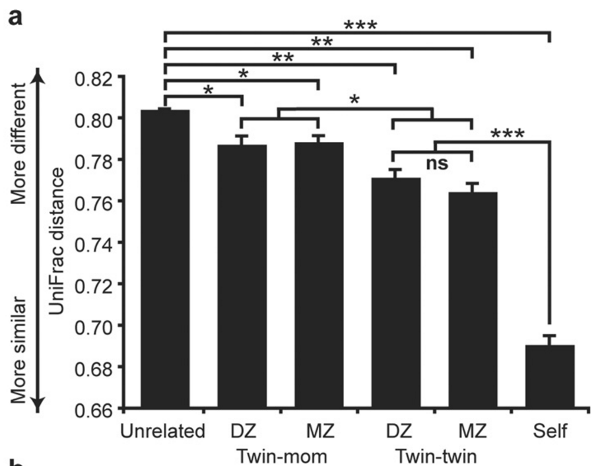
Compositional variability between individuals
Notes:
Koenig et al., PNAS, 2010
Turnbaugh et al., Nature, 2006, 2009
Arrieta et al., Front. Immunol. 2014
Ridaura et al., Science, 2013 (Perspective by Walker and Parkhill 2013)
Caporaso et al., Genome Biol, 2011

Slide 14
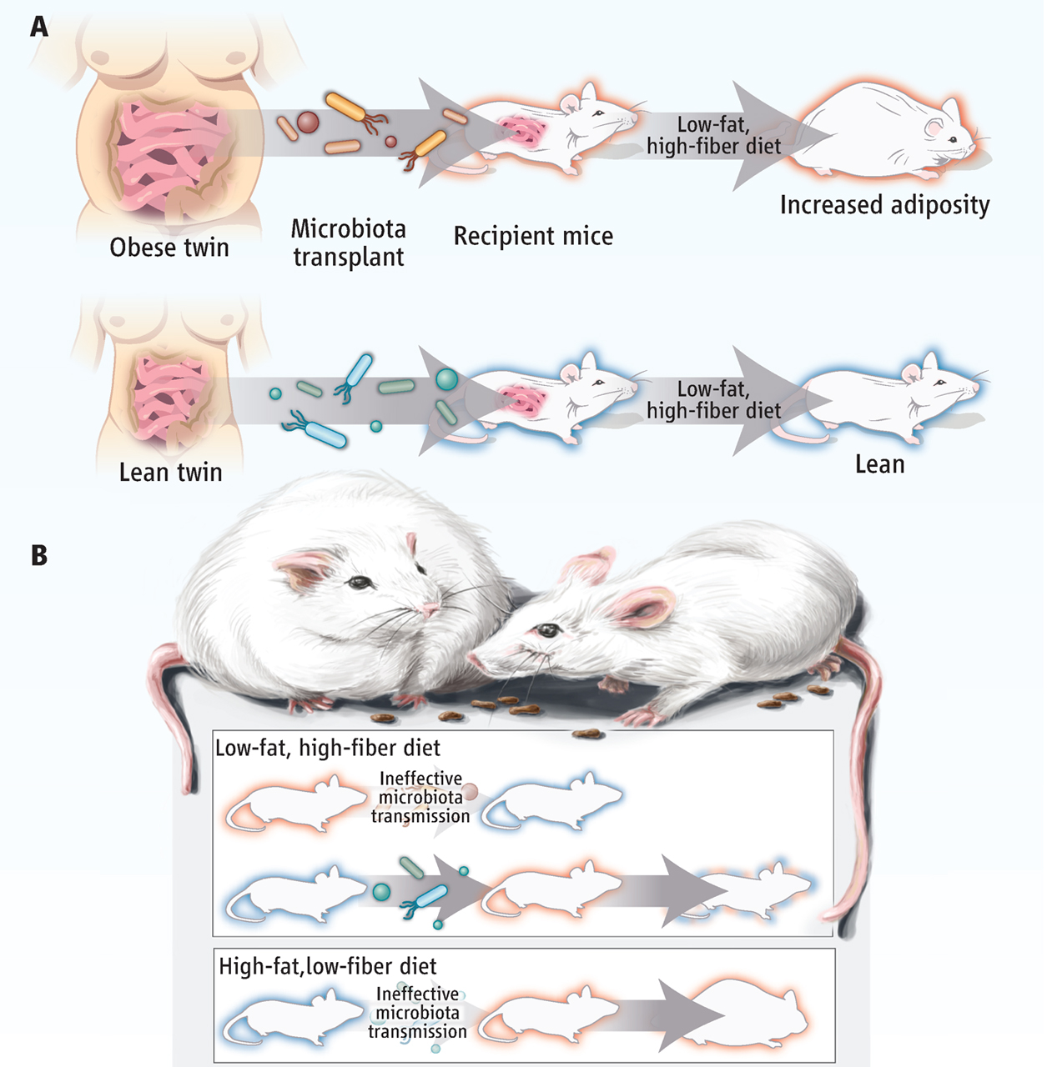
Microbiota and disease – obesity
Ridaura et al., Science, 2013
Perspective by Walker and Parkhill 2013
Notes:
Koenig et al., PNAS, 2010
Turnbaugh et al., Nature, 2006, 2009
Arrieta et al., Front. Immunol. 2014
Ridaura et al., Science, 2013 (Perspective by Walker and Parkhill 2013)
Caporaso et al., Genome Biol, 2011

Slide 15
Human gut microbiome in health and disease
Obesity
Ridaura et al, Science, 2013
Disentangling the effects of type 2 diabetes
and metformin on the human gut microbiota
Forslund, et al., Nature, 2016
Diabetes
Metabolic syndrome
Le Chatelier, et al, Nature, 2013
Autism
And other diseases
Crohn’s, Ulcerative
Colitis, MS, Parkinson,
→ Colorectal cancer
Hsiao et al, Cell, 2013
Liver cirrhosis
Qin et al, Nature, 2014
For obesity, causality (partly) established, for other diseases: correlation != causation

Slide 16
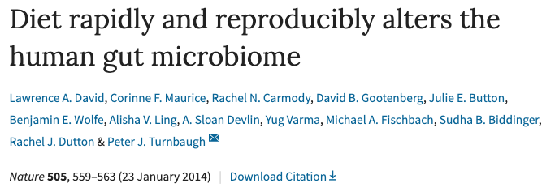
Diet shifts change human gut microbiota composition

Slide 17
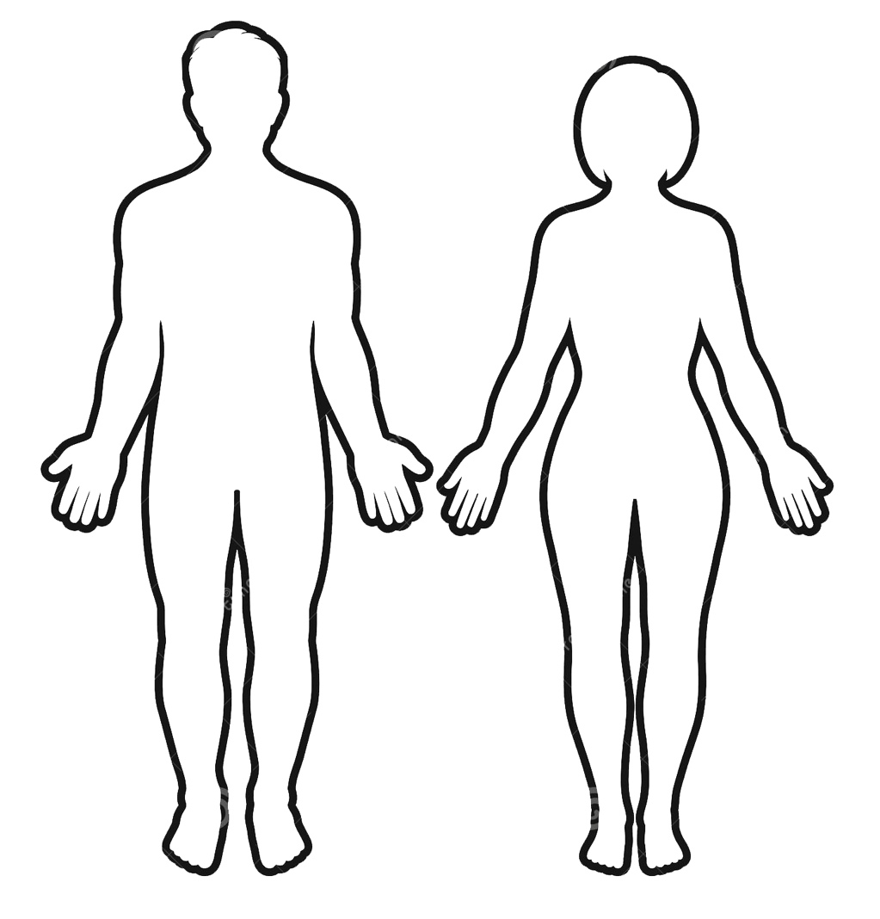
Block course experiment: Experimental design
DIET
INTERVENTION
1
DIET
INTERVENTION
2
Stool sample
HIGH FAT
+
E. Coli NISSLE
LOW FAT
GROUP A
BASELINE
WASH-OUT
1
WASH-OUT
2
LOW FAT
HIGH FAT
+
E. Coli NISSLE
GROUP B

