Slide 1
MIM workshop: General principles of scientific writing 11./12. Sep. 2019
Shinichi Sunagawa

Slide 2
Web resource
Course material
https://sunagawalab.ethz.ch/MIM_ScientificWriting/HS-2019

Slide 3
S01xE01: Intro: Why am I here, what do I expect
Collected answers
Learn about differences between scientific and other types (e.g., novel) of writing
Structured writing (e.g., individual sections, references)
Improve on writing style, learn about rules of scientific writing
Improve clarity of writing and coherence of whole manuscript
Learn about do’s and dont’s in scientific writing (including Figs and Tables)
Learn how to teach writing
Learn how to communicate science (to diverse audience)
Tools for more efficient and effective writing

Slide 4
S01xE02: IMRD format and its varieties
In pairs, please select a journal and for the format of an original scientific article, find out about:
How the manuscript should be structured (sections)?
What the length limitations are (characters, words, pages)?
How many display items are allowed?
How many references may be used?

Slide 5
General structure of a scientific manuscript
Title
Abstract
Introduction
Materials and Methods
Results
Discussion
Conclusions
References
Figures
Tables
Acknowledgements
Supplementary Material
etc.

Slide 6
S01: Take home messages
Space, that is, length of text, number of figures/tables, number of citations, is limited.
Clear, concise, structured writing and presentation is essential.
→ Make your words count!
Journal-specific instructions require planning from the very beginning.

Slide 7
S02xE01: reading scientific papers
In pairs, please use the papers you chose as a good example, and discuss why you found the paper to be particularly good/motivating/inspiring.
NOTE: do not discuss the scientific content, but rather:
how did you find it?, how did find out what it is about?, what caught your attention when reading it?, where do you find the key messages?
Please discuss and write down the points you find.

Slide 8
S03xE01: Titles – the good, the bad, the ugly
Individually, select a journal and check out its table of content
Rate the titles based on your feeling whether they are good or bad
Select one good and one bad example

Slide 9
Good examples
TCR sequencing reveals the distinct development of fetal and adult human v-gamma9 v-delta2 T-cells
conclusion of the work in one sentence
Mechano-sensation of cyclical force by piezo1 is essential for innate immunity
mechanism explained in one sentence
Engineered root bacteria release plant-available phosphate from phytate
easy to understand, explains a mechanism
Interspecies inhibition of P. gingivalis by yoghurt-derived L. delbruki requires active pyruvate oxidase
[…]
Germline variability and tumor expression level of ribosomal protiein gene rpl28 are associated with survival of metastatic colorectal cancer patients
[…]
Bad examples
AHR activation leads to massive mobilization of myolide-derived supressor cells with immunosupressive activity through regulation of CXCR2 and microRNA mir-150-5p and mir-543-3p that target anti-inflammatory genes
long, use of many abbreviations
long but good?, abbreviations ok for experts
Information gerrymandering and undemocratic decisions
cryptic?
Fludised landslides triggered by the liquifection of subsurface volcanic deposits during the 2018 Iburi/Tobu earthquake, Hokkaido
ok example, descriptive but not explanatory; unclear
S. decoloratiense LDS1 chromate resistance
no explanation, no verb / not proper sentence
Biological surface properties in extra-cellular vesicles and their effect on cargo proteins
does not convey a message
ok for review article

Slide 10
S02.1: Take home messages
Title should ideally convey the conclusion of the work
Abstract is the selling pitch and often critical whether the paper is read or not

Slide 11
S02xE02: writing an abstract
Individually, prepare a 1 min elevator pitch on the background, content, latest results and significant of your research.
In pairs, explain your research to each other within 1 min (sharp). At this stage, do not ask questions.
After that, ask follow up questions on details that were not clear in the first round.
Write down, as bullet points, your improved elevator pitch

Slide 12
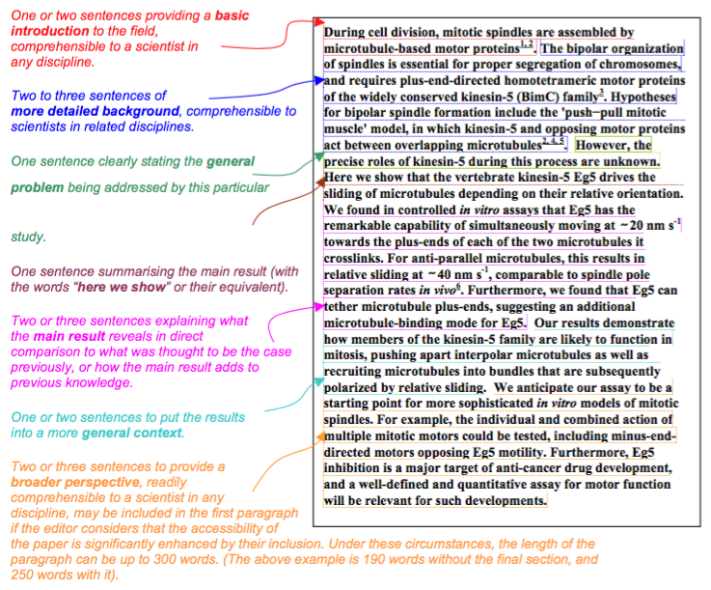
The Abstract – template by Nature
https://sunagawalab.ethz.ch/MIM_ScientificWriting/HS-2019
https://cbs.umn.edu/sites/cbs.umn.edu/files/public/downloads/Annotated_Nature_abstract.pdf

Slide 13
S02xE02: writing an abstract
Use the summary paragraph for Nature and write full sentences for a draft abstract of your own work

Slide 14
S02: Take home messages
Brainstorming and explaining to others, getting feedback and reviewing your ideas are powerful steps that help writing well-structured, concise abstracts directed towards a specific target audience.
Abstract should provide answers to 4 questions:
Why did I start? -> Background/Significance
What did I do? / How did I do it? -> Material/Methods
What did I find? -> Results
What does it mean? -> Discussion/Conclusion
Skeleton first, add meat, cosmetics last

Slide 15
Introduction: why did I start?
Guide the reader from a general/theoretical description of the topic to the very specific question or hypothesis you are aiming to investigate
indicate why the general research area is of importance
indicate the need to extend previous work
announce the experimental procedure and general findings

Slide 16
Materials and Methods: what did I do?
Accurate description of materials and methods
Necessary and sufficient information for reproducing all results
Pay attention to use of units, vendor details, software version used, etc.

Slide 17
Results: what did I find?
Section title that explains the purpose or the main question
Methods are briefly mentioned
Results are presented (figures, tables)
Simple explanation/conclusion can be mentioned
Tables/figures and individual sub-parts of figures, as well as supplementary figures, must appear in the order in which they are mentioned in the text.

Slide 18
Discussion: what does it mean?
reference to the main purpose or hypothesis of the study
brief summary of the most important findings
discuss possible explanations for the findings and compare them to other investigations/publications
state some limitations of the study
explain potential wider implications of the study
end your report with an open question or a small statement what needs be addressed in the future

Slide 19
References
follow the journal format for references and citations in the text
Mendeley, Endnote, ReadCube, etc.
Live manuscripts (google docs)
allows for real-time editing

Slide 20
General considerations
Learning scientific writing is similar to learning a language
Concise, accurate, structured, non-redundant
Example: “Due to the fact of more run-off into the water, the end result is more bacteria in the water.”
Revision: “Higher levels of bacteria are caused by increased run-off.”
Avoid:
non-quantitative adjectives (many/lots, some, little, very)
ambiguous wording, grammar
“Using multiple-regression techniques, the animals in Experiment I …”

Slide 21
S03xE01: Power of position
Fleming, in 1929, discovered penicillin after a bacterial plate he was culturing became contaminated with a spore of the fungus Penicillium.
Re-order the sentence in as many ways as possible to put emphasis on different aspects.

Slide 22
S03xE02: Cohesion vs Coherence
We start with the sentence: “Fleming, in 1929, discovered penicillin after a bacterial plate he was culturing became contaminated with a spore of the fungus Penicillium”
You will write a “paragraph” by sequentially adding a new sentence knowing only the preceding one.

Slide 23
S03xE02: Cohesion vs Coherence
Result: Fleming, in 1929, discovered penicillin after a bacterial plate he was culturing became contaminated with a spore of the fungus Penicillium.
This is how antibiotics were discovered for the first time. The discovery contributed to the improvement of human health. However, as a new discovery, safety for humans had to be tested first. To achieve this, millions of mice had to be sacrificed.
→ until here, the passage is coherent as it focuses on the topic “discovery”
Specific organs were collected and prepared for cryo-EM. Organs were fixed in EtOH and 5um sections prepared. Microscopy revealed that certain cells showed overexpression of gene XY.
→ the following sentence introduce new topics, unrelated to the previous one.

Slide 24
S03xE02: Cohesion vs Coherence
Compare the following passages A) and B). Which one appears to be more coherent? Why?
A) Consistent ideas toward the beginnings of sentences, especially in their subjects, help readers understand what a passage is generally about. A sense of coherence arises when a sequence of topics comprises a narrow set of related ideas. But the context of each sentence is lost by seemingly random shifts of topics. Unfocused paragraphs result when that happens.
B) Readers understand what a passage is generally about when they see consistent ideas toward the beginning of sentences, especially in their subjects. They feel a passage is coherent when they read a sequence of topics that focuses on a narrow set of related ideas. But when topics seem to shift randomly, readers lose the context of each sentence. When that happens, they feel they are reading paragraphs that are unfocused end even disorganized.

Slide 25
S03.1: Take home messages
Use power of position to keep writing structured and logical to help reader follow easily.
Sentences are cohesive if they share a topic/idea. A passage/paragraph may, however, not be coherent if it contains too many topics/ideas.
Each paragraph aims at communicating a specific topic/idea. Coherence is achieved when this topic/idea is followed throughout.
For clarity, sentences need to be cohesive and paragraphs coherent.

Slide 26
S03xE04: Figures – the good, the bad, the ugly
Individually, look up the figures of the same manuscript: http://www.pnas.org/content/114/36/9623.full
Take a look at the figures and captions and make suggestions, how they could be improved
Ten simple rules for better figures (paper): https://journals.plos.org/ploscompbiol/article?id=10.1371/journal.pcbi.1003833

Slide 27
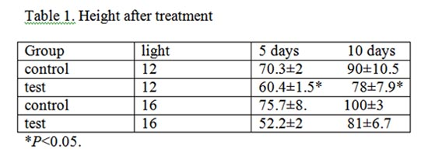
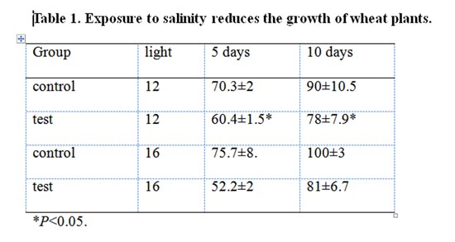
Tables
Use clear and informative titles

Slide 28
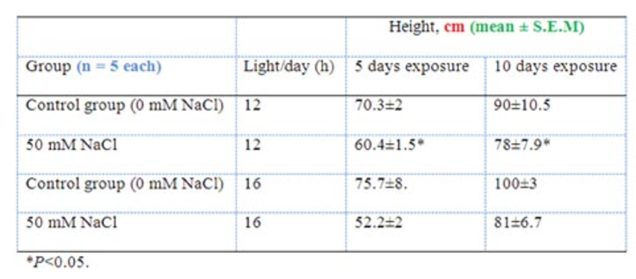
Tables
Use informative row and column titles, units, error values and sample sizes
Table 1. Exposure to salinity reduces the growth of wheat plants

Slide 29
S03.2: Take home message
Convey a message in the title of figure captions and table headers (rather than describing the obvious)

Slide 30
S04xE01: Efficient writing
Brainstorm factors that help you or prevent you from writing

Slide 31
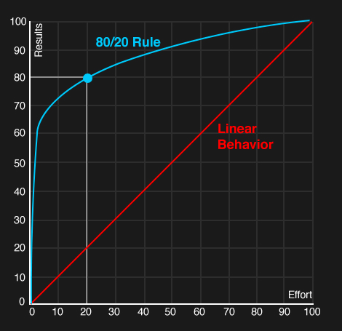
Time management & Pareto
The Pareto principle
David Lindsay: A guide to scientific writing.

Slide 32
S04: Take home messages
Set goals with time lines, meet them.
If you do not meet them, revise accordingly.
Eisenhower matrix + Pareto’s principle can be helpful in managing your time.

Slide 33
Perspective of others
Try as hard as possible to read your report/manuscript as if you were an uninformed first-time reader
Have your manuscript read by an colleague / someone unfamiliar with the details of the work

Slide 34
Summary day 1
Be aware about the form and function of TAIMRD
Divide work into chunks and set deadlines, manage your time
Brainstorm & sort; bullet points first, then write, then beautify
Revise after your write, not while you write
Being an active reader will make you a better writer
Know what readers expect and fill that expectation
Pay attention to mistakes when reading papers
During revision, check for structural, logic and stylistic mistakes
Check “rules”, use power of position, …
Get feedback and revise

Slide 35
Targeting audience / cover letter
S05xE01: Read abstract of Helfrich et al. 2018; highlight expressions, terminology, etc. that may be difficult to understand for a layperson. Next, read the corresponding press release and compare the language used (definitions, jargon, etc.), and identify what has been paraphrased.
S05xE02: Cover letter writing: target the editor as a reader (between layperson and field-specific expert). Draft a cover letter for the editor of the journal in which your would like to see your work published. Your aim is to convince him/her about the novelty and significance of your work and why this is interesting for the readership of the journal.

Slide 36
Improve clarity: 10 examples of cumbersome writing
Cluster of nouns
Clusters of adjectives
Subordinate clauses at beginning of sentence
Nouns derived from verbs
Filler verbs / words
Passive vs active
Use of imprecise words
Use of compound prepositions
Use of multiple negatives
Use of unfamiliar abbreviations, symbols and references
David Lindsay: A guide to scientific writing.

Slide 37
Resources
“A guide to scientific writing”, David Lindsay (basic)
“Style”, Joseph M. Williams (advanced)
Course material:
http://sunagawalab.ethz.ch/MIM_ScientificWriting/HS-2018
Rich online resource for scientific writing:
https://www.aje.com/en/arc/

Slide 38
Assignment
Research report due on 19. September 2019
max. 1500 words, 1 fig and/or 1 table.
TAIRD (MM if needed)
include citations, but no bibliography needed
You will receive your certificate upon receipt of report

Slide 39
Feedback
What was not very useful to me?
What was missing?
Would you recommend this course to others?

