Slide 1
MIM workshop: General principles of scientific writing 20./21. Sep. 2021
Shinichi Sunagawa

Slide 2
First things first…
COVID-19 measures
Course website/material
https://sunagawalab.ethz.ch/MIM_SW/HS-2021
Requirements for credit
Participation + report (due on 29. September 2021)

Slide 3
S01xE01: Why am I here, what do I expect
Collected answers HS2021
How to write efficiently, getting started
Share experience of writing (use of specific terms, style)
Identify important parts of writing and get started
Keep story logical and interesting
Communicate clearly (also to general audience)
Specifics on article writing: improve writing style
Logic of writing: looking for rules
Paper vs grant (vs review) writing: differences?
Distil and simplify sentences: improve clarity & coherence
Importance of peer review
Common mistakes (do’s and don'ts)

Slide 4
S01xE01: Why am I here, what do I expect
Collected answers HS2019
Learn about differences between scientific and other types (e.g., novel) of writing
Structured writing (e.g., individual sections, references)
Improve on writing style, learn about rules of scientific writing
Improve clarity of writing and coherence of whole manuscript
Learn about do’s and dont’s in scientific writing (including Figs and Tables)
Learn how to teach writing
Learn how to communicate science (to diverse audience)
Tools for more efficient and effective writing

Slide 5
S01xE02: Alignment of writing and audience
Please read the abstract of Helfrich et al. 2018; highlight expressions, terminology, etc. that may be difficult to understand for a layperson (5 min).
Next, please read the corresponding press release (Helfrich et al. 2018-press_release) and compare the language used (definitions, jargon, etc.), and identify what has been paraphrased.

Slide 6
S01xE02: Alignment of writing and audience
Plants are colonized by phylogenetically diverse microorganisms that affect plant growth and health. Representative genome-sequenced culture collections of bacterial isolates from model plants, including Arabidopsis thaliana, have recently been established. These resources provide opportunities for systematic interaction screens combined with genome mining to discover uncharacterized natural products. Here, we report on the biosynthetic potential of 224 strains isolated from the A. thaliana phyllosphere. Genome mining identified more than 1,000 predicted natural product biosynthetic gene clusters (BGCs), hundreds of which are unknown compared to the MIBiG database of characterized BGCs. For functional validation, we used a high-throughput screening approach to monitor over 50,000 binary strain combinations. We observed 725 inhibitory interactions, with 26 strains contributing to the majority of these. A combination of imaging mass spectrometry and bioactivity-guided fractionation of the most potent inhibitor, the BGC-rich Brevibacillus sp. Leaf182, revealed three distinct natural product scaffolds that contribute to the observed antibiotic activity. Moreover, a genome mining-based strategy led to the isolation of a trans-acyltransferase polyketide synthase-derived antibiotic, macrobrevin, which displays an unprecedented natural product structure. Our findings demonstrate that the phyllosphere is a valuable environment for the identification of antibiotics and natural products with unusual scaffolds.

Slide 7
S01xE02: Alignment of writing and audience
A team of ETH researchers led by Julia Vorholt and Jörn Piel have discovered new antibiotic substances in bacteria that colonise the leaf surfaces of a local wild plant. A wide variety of different microorganisms, such as bacteria and fungi, live on the leaves of plants. Although they offer few nutrients, leaf surfaces are densely populated. In an effort to keep the competition at bay, many of the leaf dwellers turn to chemical warfare: they develop antibiotic substances that prevent the growth and reproduction of their fellow occupants. During a systematic search of the leaves of thale cress (Arabidopsis thaliana), a group of researchers led by the ETH professors Julia Vorholt and Jörn Piel from the Institute of Microbiology have now discovered a remarkably chemically productive bacterium: Brevibacillus sp. Leaf 182. In experiments, it inhibited half of the 200 strains that the researchers had isolated from the leaf surfaces. The bacterium produces and secretes at
least four antibiotic chemical compounds. Two of these compounds were
already known, while a substance called macrobrevin presented a previously unknown chemical structure.

Slide 8
S01xE02: Alignment of writing and audience
"Using bioinformatic methods, we looked for groups of genes that generally control the production of substances and could thus have effects on other bacteria," explains Vorholt. At the same time, the researchers performed laboratory tests to determine which of these strains have an antibiotic effect on other strains, ensuring that certain bacteria can no longer reproduce. In total, they discovered over 700 such antibiotic interactions between different microbial strains. The aim of the project, which is funded through SNSF and ERC grants, was to find new antibiotics in a previously unexplored habitat. "Until now, research has focused particularly on soil as a habitat; however, we keep finding the same substances," says Vorholt.
The search for new antibiotics is becoming more and more difficult, with Piel speaking of the antibiotics crisis: "We hardly have any antibiotics now that at least one pathogen is not resistant to." He says that companies have more or less suspended the search for new substances because they are not considered profitable enough. With their project, the ETH researchers are tapping into a new reservoir with great potential. "We will now determine whether macrobrevin and other newly discovered substances are also effective against bacteria that cause diseases in humans," says Piel. But in his opinion, the even greater achievement is having shown that there are still many natural antibiotic substances waiting to be discovered in the microcosms of leaf surfaces, which until now have not been thoroughly investigated. "This incredibly diverse ecosystem can most definitely still offer medicine many new leads. Our results confirm that it is worth expanding the search for antibiotics in nature."

Slide 9
S01: Take home message I
Using appropriate language for target audience is key to scientific writing (and oral presentations, too!)
Tool: Try as hard as possible to read your own writing from the perspective of a non-informed reader

Slide 10
S02xE01: Individual parts of scientific papers
Please look up a paper you read recently that you found to be particularly good/motivating/inspiring.
In pairs, discuss:
how you found it?
how you found out what it is about?
what caught your attention when reading it?
where you found the key messages?
rather than discussing the scientific content.

Slide 11
S02xE01: Individual parts of scientific papers
«Good» paper
how you did you find it?
Meeting -> Author website -> list of publications -> title
Home lab -> journal mailing list -> reading titles
Target authors – meeting -> mailing list
Search key words on PubMed
Filter by year of publication
how you did you find out what it is about?
Read title, check for key words
Scan through abstract, search for key words
Check who are the authors
what caught your attention when reading it?
Methods used: can be found in abstract and methods part of the paper
Titles -> Abstract -> Figures
Clear writing
where did you find the key messages?
Abstract and end of introduction
Beginning and end of Introduction combined with beginning of Discussion

Slide 12
S02xE02: Titles – the good, the bad, the ugly
Individually, select a journal and check out its table of content
Rate the titles based on your feeling whether they are good or bad
Select one good and one bad example

Slide 13
Good examples HS2021
Antigen and checkpoint receptor engagement recalibrates T-cell receptor signal strength
Virus-induced senescence is driver and therapeutic target in COVID19
Genomic and functional characterization of a mucosal symbiont is involved in early stage colorectal cancer
Fc-engineered antibody therapeutic with improved anti-SARS-COVID efficacy (vote for bad)
Quantitative evaluation of chromosomal rearrangements in gene-edited human stem cell by Cast-seq
An easily swallowed capsule injects drugs straight into the gut
-> more details, active description, key messages
Bad examples HS2021
Regulatory T-cell function in established systemic inflammation and reverse fatal autoimmunity
A modern world view of host-microbiota pathogen interactions
Continuous mott transition in semiconductor moire super lattices
-> general, abstract

Slide 14
Good examples HS2020
Opposing activities of NOTCH and wnt signaling regulate intestinal stem cells and gut homeostasis
Memory B-cell activate brain homing autroreactive CD4+ T-cells in MS
Short range interactions govern the dynamics and functions of microbial communities
Nitrogen-fixing rhizobial strains isolated from common bean seeds: phyogeny, physiology and genome analysis
Analysis of membrane proteins localizing to the inner nuclear envelope in living cells
Eosinophils from murine lamina propria induce differentiation of naïve T-cells into Tregs via
Bioremediation of a common product of food processing by a human gut bacterium
Multiplexed single cell morphometry for hematopathology diagnostics
An RPSL cassette, janus, for gene replacement through negative selection in Strep.
Bad examples HS2020

Slide 15
Good examples HS2019
TCR sequencing reveals the distinct development of fetal and adult human v-gamma9 v-delta2 T-cells
conclusion of the work in one sentence
Mechano-sensation of cyclical force by piezo1 is essential for innate immunity
mechanism explained in one sentence
Engineered root bacteria release plant-available phosphate from phytate
easy to understand, explains a mechanism
Interspecies inhibition of P. gingivalis by yoghurt-derived L. delbruki requires active pyruvate oxidase
[…]
Germline variability and tumor expression level of ribosomal protiein gene rpl28 are associated with survival of metastatic colorectal cancer patients
[…]
Bad examples HS2019
AHR activation leads to massive mobilization of myolide-derived supressor cells with immunosupressive activity through regulation of CXCR2 and microRNA mir-150-5p and mir-543-3p that target anti-inflammatory genes
long, use of many abbreviations
long but good?, abbreviations ok for experts
Information gerrymandering and undemocratic decisions
cryptic?
Fludised landslides triggered by the liquifection of subsurface volcanic deposits during the 2018 Iburi/Tobu earthquake, Hokkaido
ok example, descriptive but not explanatory; unclear
S. decoloratiense LDS1 chromate resistance
no explanation, no verb / not proper sentence
Biological surface properties in extra-cellular vesicles and their effect on cargo proteins
does not convey a message
ok for review article

Slide 16
S02: Take home messages I
Title + abstract: often the only freely accessible information. Need to be interesting + informative and motivate the reader to continue reading the whole paper
Title should ideally convey the result/conclusion of the work
Abstract is the selling pitch and often critical whether the paper is read or not

Slide 17
S02xE03: writing an abstract
Individually, prepare a 1 min elevator pitch on the background, content, latest results and significant of your research.
In pairs, explain your research to each other within 1 min (sharp). At this stage, do not ask questions.
After that, ask follow up questions on details that were not clear in the first round.
Write down, as bullet points, your improved elevator pitch

Slide 18
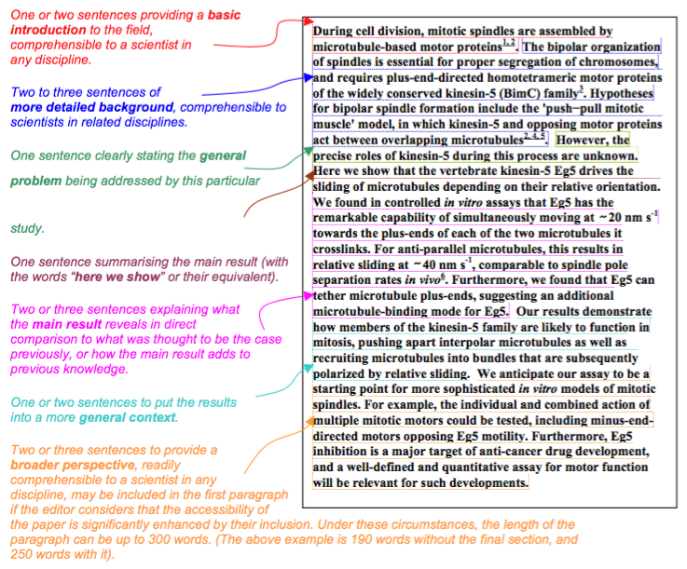
The Abstract – template by Nature
https://sunagawalab.ethz.ch/MIM_SW/HS-2021/2-Annotated_Nature_abstract.pdf

Slide 19
S02xE03: writing an abstract
Use the summary paragraph for Nature and write full sentences for a draft abstract of your own work

Slide 20
S02: Take home messages II
Brainstorming and explaining to others, getting feedback and reviewing your ideas are powerful steps that help writing well-structured, concise abstracts directed towards a specific target audience.
Abstract should provide answers to 4 questions:
Why did I start? -> Background/Significance
What did I do? / How did I do it? -> Material/Methods
What did I find? -> Results
What does it mean? -> Discussion/Conclusion
Tool: General strategy for efficient writing:
build skeleton first, add meat, cosmetics last

Slide 21
Lunch break until 13:30

Slide 22
S03: The content: efficient and effective writing
Original research articles
Reviews
Text books
→An apprentice believes everything, a researcher believes nothing
How do we know if something is true or not? “Do we really know?”
Knowledge is generated by the accumulation of good evidence
How do we know if evidence is good or bad?
Providing evidence requires asking “good” questions

Slide 23
Introduction: why did I start?
Provide the reader with the necessary background to understand the very specific question or hypothesis you are aiming to investigate, and only with that background
→ typical mistake: review-type introductions
indicate why the general research area is of importance: “so what?”
indicate the need to extend previous work: “if not, what?”
announce the experimental procedure and general findings: whet appetite

Slide 24
Materials and Methods: what did I do?
Accurate description of materials and methods used to generate the data of your work
Necessary and sufficient information for reproducing all results
Pay attention to use of units, vendor details, software version used, etc.

Slide 25
Results: what did I find?
Write results “around” your data, i.e., figures and tables
Methods can be mentioned, but only as much detail as needed to understand data

Slide 26
Discussion: what does it mean?
Reference to the main purpose or hypothesis of the study
→ Re-read Introduction and Discussion (skip Methods and Results)
Turn summary of the most important findings into implications
→ “Our finding that A impacts B shows …”
Put results into context by comparing them to state-of-the-art
→ “Our study corroborates…”; “Our results contrasts previous findings…”
State limitations of the study, but in a non-defensive (forward-looking) way:
“To further generalize our findings, future studies should […]”
Explain wider implications of the study and future directions

Slide 27
References
follow the journal format for references and citations in the text
Mendeley, Endnote, ReadCube, etc.

Slide 28
General rules
Space, that is, length of text, number of figures/tables, number of citations, is limited. Therefore, scientific writing is accurate, structured, clear, non-redundant and concise.
General rule: Write your text as long as required to understand in as few words as possible.
Example: “Due to the fact of more run-off into the water, the end result is more bacteria in the water.”
Revision: “Higher levels of bacteria are caused by increased run-off.”
Avoid:
non-quantitative adjectives (many/lots, some, little, very)
ambiguous wording, grammar
“Using multiple-regression techniques, the animals in Experiment I …”

Slide 29
A critical reader is/becomes a better writer
Is the state of the art well described? Is prior work referenced?
Is the specific knowledge/method gap identified (usually by question and/or hypothesis: Q and H)?
Is the relevance of Q and H described?
Are the experiments/analyses aligned to Q and H?
What evidence do the data exactly provide? Are limitations / alternative explanations adequately discussed?
Are claims aligned with questions? Do they close the specific gaps?
Are claims overstated/-sold?
Methodology: adequate, timely, solid
Is the presentation (text, display items) accessible (i.e., easy to understand)?
How significant is the impact/advance?
Check for errors/negligence/sloppiness

Slide 30
S03: Take home message I
Critical reader = better writer
Tool: Read manuscripts like a robot (i.e., without any pre-assumptions)
Relevance: a good research question has significant consequences if it remains unanswered
Tool: Ask the question “So what?”

Slide 31
S03xE01: Power of position
Fleming, in 1929, discovered penicillin after a bacterial plate he was culturing became contaminated with a spore of the fungus Penicillium.
Re-order the sentence in as many ways as possible to put emphasis on different aspects.

Slide 32
S03xE02: Cohesion vs Coherence
We start with the sentence: “Fleming, in 1929, discovered penicillin after a bacterial plate he was culturing became contaminated with a spore of the fungus Penicillium”
You will write a “paragraph” by sequentially adding a new sentence knowing only the preceding one.

Slide 33
Cohesiveness
Result HS2020
Fleming, in 1929, discovered penicillin after a bacterial plate he was culturing became contaminated with a spore of the fungus Penicillium.
This way, he opened new avenues in how drugs can be discovered.
He furthered his research by focusing on isolating bacteria from the soil.
He then plated the bacteria on agar plates.
He found the bacteria weren’t growing.
Therefore, he searched for the cause.
Using high-throughput sequencing, he discovered 1000 new identities.
Antibiotics produced by this specific strain of this fungus, can be used to treat infections.
However, further studies should be conducted.
→ Sentences appear cohesive and the paragraph coherent, b/c the subject does not (significantly) change and sentences are conceptually linked (through hints provided by keywords).

Slide 34
S03xE02: Cohesion vs Coherence
Result HS2020: Fleming, in 1929, discovered penicillin after a bacterial plate he was culturing became contaminated with a spore of the fungus Penicillium.
This is how antibiotics were discovered for the first time. The discovery contributed to the improvement of human health. However, as a new discovery, safety for humans had to be tested first. To achieve this, millions of mice had to be sacrificed.
→ until here, the passage is coherent as it focuses on the topic “discovery”
Specific organs were collected and prepared for cryo-EM. Organs were fixed in EtOH and 5um sections prepared. Microscopy revealed that certain cells showed overexpression of gene XY.
→ the following sentence introduce new topics, unrelated to the previous one.

Slide 35
S03xE02: Cohesion vs Coherence
Compare the following passages A) and B). Which one appears to be more coherent? Why?
A) Consistent ideas toward the beginnings of sentences, especially in their subjects, help readers understand what a passage is generally about. A sense of coherence arises when a sequence of topics comprises a narrow set of related ideas. But the context of each sentence is lost by seemingly random shifts of topics. Unfocused paragraphs result when that happens.
B) Readers understand what a passage is generally about when they see consistent ideas toward the beginning of sentences, especially in their subjects. They feel a passage is coherent when they read a sequence of topics that focuses on a narrow set of related ideas. But when topics seem to shift randomly, readers lose the context of each sentence. When that happens, they feel they are reading paragraphs that are unfocused end even disorganized.

Slide 36
S03: Take home messages II
Use power of position to keep writing structured and logical to help reader follow easily.
Sentences are cohesive if they share a topic/idea. A passage/paragraph may, however, not be coherent if it contains too many topics/ideas.
Each paragraph aims at communicating a specific topic/idea. Coherence is achieved when this topic/idea is followed throughout.
For clarity, sentences need to be cohesive and paragraphs coherent.

Slide 37
S04: Become an analytical reader
Rather than reading a piece of writing to understand the content it aims to convey, read analytically:
What is the topic of this paragraph?
What is the paragraph trying to convey?
Are the sentences cohesive and the paragraph coherent?
Is the “power of position” used efficiently?
Is the writing clear? Can sentences be divided to improve clarity?
Are there grammatical errors?
Figures and Tables: does the information provided convey a message? Is all required information presented?

Slide 38
S04xE01: Analytical reading of an article
Download the manuscript:
https://sunagawalab.ethz.ch/MIM_SW/HS-2021/cfDNA_paper.pdf
Read through analytically and make notes of what you find
Take a look at the figures and captions and make suggestions, how they could be improved

Slide 39
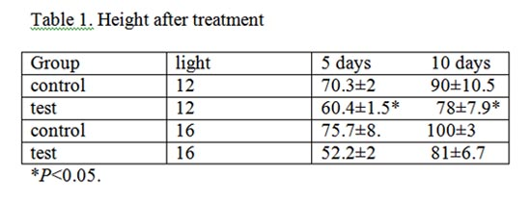
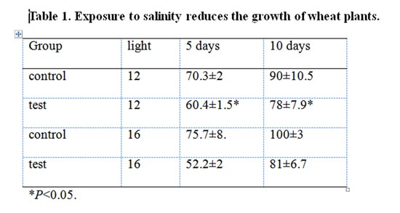
Tables
Use clear and informative titles

Slide 40
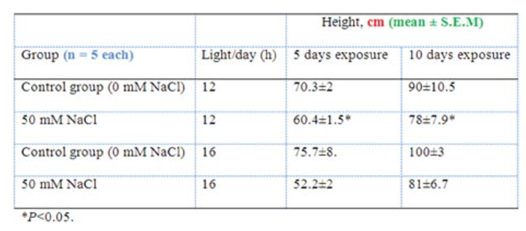
Tables
Use informative row and column titles, units, error values and sample sizes
Table 1. Exposure to salinity reduces the growth of wheat plants

Slide 41
S04: Take home messages I
Convey a message in the title of figure captions and table headers (rather than describing the obvious)

Slide 42
S04xE02: Effective writing
Research article: hour-glass structure
Proposals, news articles: front loaded structure
Make your arguments count: “why should I care?”, “what would be the consequence, if I did not care?"

Slide 43
S04xE03: Efficient writing
Brainstorm factors that help you or prevent you from writing
quiet environment
deadline: https://www.ted.com/talks/tim_urban_inside_the_mind_of_a_master_procrastinator
follow up quickly / not right after experiments
in the lab (not at home); in-between work
morning hours (better focus)
no distractions
structure (time) / rather no time constraints
→ Optimal conditions differ from person to person

Slide 44
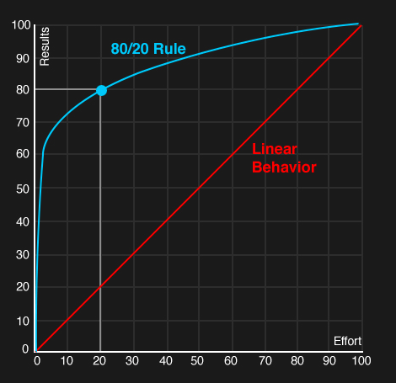
Time management & Pareto
The Pareto principle
David Lindsay: A guide to scientific writing.

Slide 45
S04: Take home messages
Set goals with time lines, meet them.
If you do not meet them, revise accordingly.
Eisenhower matrix + Pareto’s principle can be helpful in managing your time.

Slide 46
S05: Better reader = better writer
S05xEx01 - Recap and homework
- Summarize the tools you learned today
- For next day, read the “Draft manuscript” and answer the following questions:
- what is the topic each paragraph? what could have been the initial bullet points for each paragraph?
- are the sentences cohesive? Is the paragraph coherent?
- is it clear why I should care?
- what is the problem?
- Edit this document by identifying issues, making suggestions, pointing out missing information, and importantly being constructive!

Slide 47
Extend your toolbox

