Slide 1
MIM workshop: General principles of scientific writing 08./09. Sep. 2020
Shinichi Sunagawa

Slide 2
First things first…
Covid-19 measures
Course material
https://sunagawalab.ethz.ch/MIM_SW/HS-2020
Room tomorrow
HCP 47.1
Requirements for credit
Participation + report (due on 16. September 2020)

Slide 3
S01xE01: Why am I here, what do I expect
Collected answers HS2020
Clear and effective communication
Tools clear and engaging writing
Lose “fear” from writing
General writing skills
Writing style / do’s and don’ts
Logically structure of a manuscript
How do I start (the first sentence)?
Improve efficiency and effectiveness in writing
Does the finding have to be interesting?
Review vs original manuscripts

Slide 4
S01xE01: Why am I here, what do I expect
Collected answers HS2019
Learn about differences between scientific and other types (e.g., novel) of writing
Structured writing (e.g., individual sections, references)
Improve on writing style, learn about rules of scientific writing
Improve clarity of writing and coherence of whole manuscript
Learn about do’s and dont’s in scientific writing (including Figs and Tables)
Learn how to teach writing
Learn how to communicate science (to diverse audience)
Tools for more efficient and effective writing

Slide 5
S01xE02: Alignment of writing and audience
Please read the abstract of Helfrich et al. 2018; highlight expressions, terminology, etc. that may be difficult to understand for a layperson (5 min).
Next, please read the corresponding press release (Helfrich et al. 2018-press_release) and compare the language used (definitions, jargon, etc.), and identify what has been paraphrased.

Slide 6
S01xE02: Alignment of writing and audience
Plants are colonized by phylogenetically diverse microorganisms that affect plant growth and health. Representative genome-sequenced culture collections of bacterial isolates from model plants, including Arabidopsis thaliana, have recently been established. These resources provide opportunities for systematic interaction screens combined with genome mining to discover uncharacterized natural products. Here, we report on the biosynthetic potential of 224 strains isolated from the A. thaliana phyllosphere. Genome mining identified more than 1,000 predicted natural product biosynthetic gene clusters (BGCs), hundreds of which are unknown compared to the MIBiG database of characterized BGCs. For functional validation, we used a high-throughput screening approach to monitor over 50,000 binary strain combinations. We observed 725 inhibitory interactions, with 26 strains contributing to the majority of these. A combination of imaging mass spectrometry and bioactivity-guided fractionation of the most potent inhibitor, the BGC-rich Brevibacillus sp. Leaf182, revealed three distinct natural product scaffolds that contribute to the observed antibiotic activity. Moreover, a genome mining-based strategy led to the isolation of a trans-acyltransferase polyketide synthase-derived antibiotic, macrobrevin, which displays an unprecedented natural product structure. Our findings demonstrate that the phyllosphere is a valuable environment for the identification of antibiotics and natural products with unusual scaffolds.

Slide 7
S01xE02: Alignment of writing and audience
A wide variety of different microorganisms, such as bacteria and fungi, live on the leaves of plants. Although they offer few nutrients, leaf surfaces are densely populated. In an effort to keep the competition at bay, many of the leaf dwellers turn to chemical warfare: they develop antibiotic substances that prevent the growth and reproduction of their fellow occupants. During a systematic search of the leaves of thale cress (Arabidopsis thaliana), a group of researchers led by the ETH professors Julia Vorholt and Jörn Piel from the Institute of Microbiology have now discovered a remarkably chemically productive bacterium: Brevibacillus sp. Leaf 182. In experiments, it inhibited half of the 200 strains that the researchers had isolated from the leaf surfaces. The bacterium produces and secretes at least four antibiotic chemical compounds. Two of these compounds were already known, while a substance called macrobrevin presented a previously unknown chemical structure.

Slide 8
S01: Take home message I
Using appropriate language for target audience is key to scientific writing (and oral presentations, too!)
Tool: Try as hard as possible to read your own writing from the perspective of a non-informed reader

Slide 9
Scientific literacy: Evidence, claim, relevance/consequence
Cutting edge research papers
Original research articles
Reviews
Text books
→An apprentice believes everything, a researcher believes nothing
How do we know if something is true or not? “Do we really know?”
Knowledge is generated by the accumulation of good evidence
How do we know if evidence is good or bad?
Providing evidence requires asking “good” questions

Slide 10
A critical reader is/becomes a better writer
Is the state of the art well described? Is prior work referenced?
Is the specific knowledge/method gap identified (usually by question and/or hypothesis: Q and H)?
Is the relevance of Q and H described?
Are the experiments/analyses aligned to Q and H?
What evidence do the data exactly provide? Are limitations / alternative explanations adequately discussed?
Are claims aligned with questions? Do they close the specific gaps?
Are claims overstated/-sold?
Methodology: adequate, timely, solid
Is the presentation (text, display items) accessible?
How significant is the impact/advance?
Check for errors/negligence/sloppiness

Slide 11
S01: Take home message II
Critical reader = better writer
Tool: Read manuscripts like a robot (i.e., without any pre-assumptions)
Relevance: a good research question has significant consequences if it remains unanswered
Tool: Ask the question “So what?”

Slide 12
S02xE01: Individual parts of scientific papers
Please look up a paper you read recently that you found to be particularly good/motivating/inspiring.
In pairs, discuss:
how you found it?
how you found out what it is about?
what caught your attention when reading it?
where you found the key messages?
rather than discussing the scientific content.

Slide 13
S02xE01: Individual parts of scientific papers
«Good» paper
how you found it?
Google keywords, social networks, citation/reference→ link, pubmed reverse search, citation manager alerts, email alerts, targeted search of labs/journal content
how you found out what it is about?
Title, graphical abstract + «in brief», google image → main figures,
what caught your attention when reading it?
Information in title, section headers, link between headers
where you found the key messages?
Title, Figure, abstract, section headers, highlights (bullet points)

Slide 14
S03xE01: Titles – the good, the bad, the ugly
Individually, select a journal and check out its table of content
Rate the titles based on your feeling whether they are good or bad
Select one good and one bad example

Slide 15
Good examples HS2020
Opposing activities of NOTCH and wnt signaling regulate intestinal stem cells and gut homeostasis
Memory B-cell activate brain homing autroreactive CD4+ T-cells in MS
Short range interactions govern the dynamics and functions of microbial communities
Nitrogen-fixing rhizobial strains isolated from common bean seeds: phyogeny, physiology and genome analysis
Analysis of membrane proteins localizing to the inner nuclear envelope in living cells
Eosinophils from murine lamina propria induce differentiation of naïve T-cells into Tregs via
Bioremediation of a common product of food processing by a human gut bacterium
Multiplexed single cell morphometry for hematopathology diagnostics
An RPSL cassette, janus, for gene replacement through negative selection in Strep.
Bad examples HS2020

Slide 16
Good examples HS2019
TCR sequencing reveals the distinct development of fetal and adult human v-gamma9 v-delta2 T-cells
conclusion of the work in one sentence
Mechano-sensation of cyclical force by piezo1 is essential for innate immunity
mechanism explained in one sentence
Engineered root bacteria release plant-available phosphate from phytate
easy to understand, explains a mechanism
Interspecies inhibition of P. gingivalis by yoghurt-derived L. delbruki requires active pyruvate oxidase
[…]
Germline variability and tumor expression level of ribosomal protiein gene rpl28 are associated with survival of metastatic colorectal cancer patients
[…]
Bad examples HS2019
AHR activation leads to massive mobilization of myolide-derived supressor cells with immunosupressive activity through regulation of CXCR2 and microRNA mir-150-5p and mir-543-3p that target anti-inflammatory genes
long, use of many abbreviations
long but good?, abbreviations ok for experts
Information gerrymandering and undemocratic decisions
cryptic?
Fludised landslides triggered by the liquifection of subsurface volcanic deposits during the 2018 Iburi/Tobu earthquake, Hokkaido
ok example, descriptive but not explanatory; unclear
S. decoloratiense LDS1 chromate resistance
no explanation, no verb / not proper sentence
Biological surface properties in extra-cellular vesicles and their effect on cargo proteins
does not convey a message
ok for review article

Slide 17
S02: Take home messages I
Title + abstract: often the only freely accessible information. Need to be interesting + informative and motivate the reader to continue reading the whole paper
Title should ideally convey the result/conclusion of the work
Abstract is the selling pitch and often critical whether the paper is read or not

Slide 18
S02xE02: writing an abstract
Individually, prepare a 1 min elevator pitch on the background, content, latest results and significant of your research.
In pairs, explain your research to each other within 1 min (sharp). At this stage, do not ask questions.
After that, ask follow up questions on details that were not clear in the first round.
Write down, as bullet points, your improved elevator pitch

Slide 19
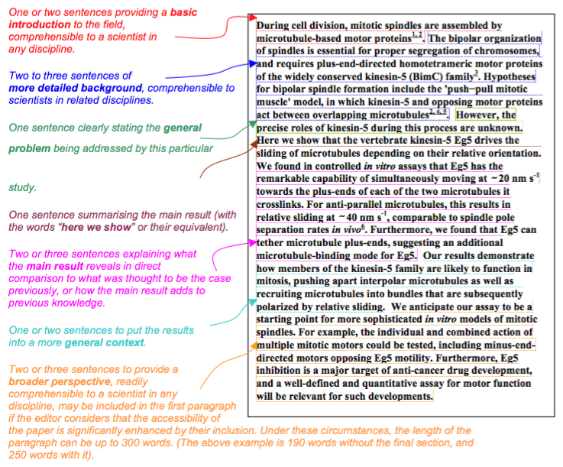
The Abstract – template by Nature
https://sunagawalab.ethz.ch/MIM_SW/HS-2020/2-Annotated_Nature_abstract.pdf

Slide 20
S02xE02: writing an abstract
Use the summary paragraph for Nature and write full sentences for a draft abstract of your own work

Slide 21
S02: Take home messages II
Brainstorming and explaining to others, getting feedback and reviewing your ideas are powerful steps that help writing well-structured, concise abstracts directed towards a specific target audience.
Abstract should provide answers to 4 questions:
Why did I start? -> Background/Significance
What did I do? / How did I do it? -> Material/Methods
What did I find? -> Results
What does it mean? -> Discussion/Conclusion
Tool: General strategy for efficient writing:
skeleton first, add meat, cosmetics last

Slide 22
Introduction: why did I start?
Provide the reader with the necessary background to understand the very specific question or hypothesis you are aiming to investigate, and only with that background
→ typical mistake: review-type introductions
indicate why the general research area is of importance: “so what?”
indicate the need to extend previous work: “if not, what?”
announce the experimental procedure and general findings: whet appetite

Slide 23
Materials and Methods: what did I do?
Accurate description of materials and methods
Necessary and sufficient information for reproducing all results
Pay attention to use of units, vendor details, software version used, etc.

Slide 24
Results: what did I find?
Section title that explains the purpose or the main question
Methods are briefly mentioned
Results are presented (figures, tables)
Simple explanation/conclusion can be mentioned
Tables/figures and individual sub-parts of figures, as well as supplementary figures, must appear in the order in which they are mentioned in the text.

Slide 25
Discussion: what does it mean?
reference to the main purpose or hypothesis of the study
brief summary of the most important findings
discuss possible explanations for the findings and compare them to other investigations/publications
state some limitations of the study
explain potential wider implications of the study
end your report with an open question or a small statement what needs be addressed in the future

Slide 26
References
follow the journal format for references and citations in the text
Mendeley, Endnote, ReadCube, etc.
Live manuscripts (platfoms for live editing)
allows for real-time editing

Slide 27
General considerations
Space, that is, length of text, number of figures/tables, number of citations, is limited. Therefore, scientific writing is accurate, structured, clear, non-redundant and concise.
General rule: Write your text as long as required to understand in as few words as possible.
Example: “Due to the fact of more run-off into the water, the end result is more bacteria in the water.”
Revision: “Higher levels of bacteria are caused by increased run-off.”
Avoid:
non-quantitative adjectives (many/lots, some, little, very)
ambiguous wording, grammar
“Using multiple-regression techniques, the animals in Experiment I …”

Slide 28
S03xE01: Power of position
Fleming, in 1929, discovered penicillin after a bacterial plate he was culturing became contaminated with a spore of the fungus Penicillium.
Re-order the sentence in as many ways as possible to put emphasis on different aspects.

Slide 29
S03xE02: Cohesion vs Coherence
We start with the sentence: “Fleming, in 1929, discovered penicillin after a bacterial plate he was culturing became contaminated with a spore of the fungus Penicillium”
You will write a “paragraph” by sequentially adding a new sentence knowing only the preceding one.

Slide 30
S03xE02: Cohesion vs Coherence
Result: Fleming, in 1929, discovered penicillin after a bacterial plate he was culturing became contaminated with a spore of the fungus Penicillium.
This is how antibiotics were discovered for the first time. The discovery contributed to the improvement of human health. However, as a new discovery, safety for humans had to be tested first. To achieve this, millions of mice had to be sacrificed.
→ until here, the passage is coherent as it focuses on the topic “discovery”
Specific organs were collected and prepared for cryo-EM. Organs were fixed in EtOH and 5um sections prepared. Microscopy revealed that certain cells showed overexpression of gene XY.
→ the following sentence introduce new topics, unrelated to the previous one.

Slide 31
S03xE02: Cohesion vs Coherence
Compare the following passages A) and B). Which one appears to be more coherent? Why?
A) Consistent ideas toward the beginnings of sentences, especially in their subjects, help readers understand what a passage is generally about. A sense of coherence arises when a sequence of topics comprises a narrow set of related ideas. But the context of each sentence is lost by seemingly random shifts of topics. Unfocused paragraphs result when that happens.
B) Readers understand what a passage is generally about when they see consistent ideas toward the beginning of sentences, especially in their subjects. They feel a passage is coherent when they read a sequence of topics that focuses on a narrow set of related ideas. But when topics seem to shift randomly, readers lose the context of each sentence. When that happens, they feel they are reading paragraphs that are unfocused end even disorganized.

Slide 32
S03.1: Take home messages
Use power of position to keep writing structured and logical to help reader follow easily.
Sentences are cohesive if they share a topic/idea. A passage/paragraph may, however, not be coherent if it contains too many topics/ideas.
Each paragraph aims at communicating a specific topic/idea. Coherence is achieved when this topic/idea is followed throughout.
For clarity, sentences need to be cohesive and paragraphs coherent.

Slide 33
S03xE04: Figures – the good, the bad, the ugly
Individually, look up the figures of the same manuscript: https://sunagawalab.ethz.ch/MIM_SW/HS-2020/cfDNA_paper.pdf
Take a look at the figures and captions and make suggestions, how they could be improved

Slide 34
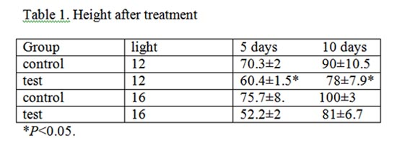
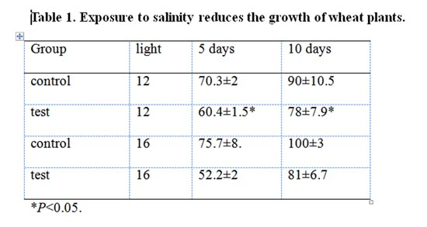
Tables
Use clear and informative titles

Slide 35
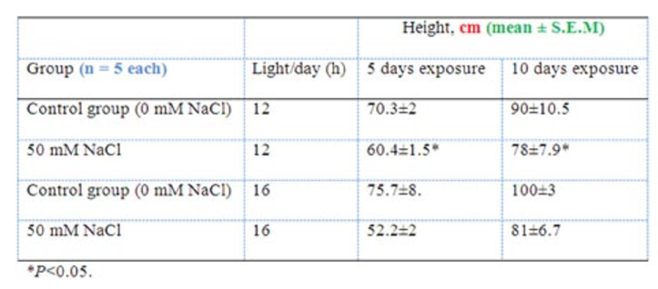
Tables
Use informative row and column titles, units, error values and sample sizes
Table 1. Exposure to salinity reduces the growth of wheat plants

Slide 36
S03.2: Take home message
Convey a message in the title of figure captions and table headers (rather than describing the obvious)

Slide 37
S04xE01: Efficient writing
Brainstorm factors that help you or prevent you from writing
quiet environment
deadline: https://www.ted.com/talks/tim_urban_inside_the_mind_of_a_master_procrastinator
follow up quickly / not right after experiments
in the lab (not at home); in-between work
morning hours (better focus)
no distractions
structure (time) / rather no time constraints
→ Optimal conditions differ from person to person

Slide 38
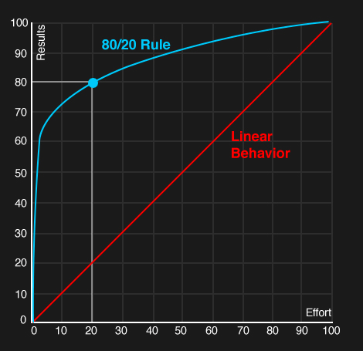
Time management & Pareto
The Pareto principle
David Lindsay: A guide to scientific writing.

Slide 39
S04: Take home messages
Set goals with time lines, meet them.
If you do not meet them, revise accordingly.
Eisenhower matrix + Pareto’s principle can be helpful in managing your time.

Slide 40
Summary day 1
Be aware about the form and function of TAIMRD
Divide work into chunks and set deadlines, manage your time
Brainstorm & sort; bullet points first, then write, then beautify
Revise after your write, not while you write
Being an active reader will make you a better writer
Know what readers expect and fill that expectation
Pay attention to mistakes when reading papers
During revision, check for structural, logic and stylistic mistakes
Check “rules”, use power of position, …
Get feedback and revise

