Slide 1
MIM workshop: General principles of scientific writing 11./12. Sep. 2018
Shinichi Sunagawa

Slide 2
S01xE00: Intro: Why am I here, what do I expect
Collected answers
Learn how to write scientifically?
formal writing | length of writing | manuscript vs thesis
How to prepare for writing a manuscript, how to get organised
„from data to paper“
Strategies of writing a whole paper
efficiency + effectiveness + 80/20 rule + from draft to final version
Do’s and dont’s in writing
rules, style, clarity
Figure/Table design, presenting data | what goes where?
Editing/revising: how to assess quality of a paper
Importance of abstract / title
Journal-specific structure/audience

Slide 3
S01xE01: IMRD format and its varieties
In pairs, please select a journal and for the format of an original scientific article, find out about:
How the manuscript should be structured (sections)?
What the length limitations are (characters, words, pages)?
How many display items are allowed?
How many references may be used?

Slide 4
General structure of a scientific manuscript
Title
Abstract
Introduction
Materials and Methods
Results
Discussion
References
Figures
Tables
Acknowledgements
Supplementary Materials

Slide 5
Introduction: why did I start?
Guide the reader from a general/theoretical description of the topic to the very specific question or hypothesis you are aiming to investigate
indicate why the general research area is of importance
indicate the need to extend previous work
announce the experimental procedure and general findings

Slide 6
Materials and Methods: what did I do?
Accurate description of materials and methods
Necessary and sufficient information for reproducing all results
Pay attention to use of units, vendor details, software version used, etc.

Slide 7
Results: what did I find?
Section are organized as the following:
Section title that explains the purpose or the main question
Methods are briefly mentioned
Results are presented (figures, tables)
Simple explanation/conclusion can be mentioned
Tables/figures and individual sub-parts of figures, as well as supplementary figures, must appear in the order in which they are mentioned in the text.

Slide 8
Discussion: what does it mean?
reference to the main purpose or hypothesis of the study
brief summary of the most important findings
discuss possible explanations for the findings and compare them to other investigations/publications
state some limitations of the study
explain potential wider implications of the study
end your report with an open question or a small statement what needs be addressed in the future

Slide 9
References
follow the journal format for references and citations in the text
Mendeley, Endnote, ReadCube, etc.
Live manuscripts (google docs)
allows for real-time editing

Slide 10
S01: Take home messages
Space, that is, length of text, number of figures/tables, number of citations, is limited. Clear, concise, structured writing and presentation is essential
→ Make your words count!
Journal-specific instructions require planning from the very beginning.

Slide 11
S02xE01: reading scientific papers
In pairs, please use the papers you chose as a good or bad example, and discuss why you found the paper to be particularly good/motivating? bad/frustrating?
NOTE: do not discuss the scientific content, but rather:
how did you find it?, how did find out what it is about?, what drew (or lost) your attention when reading it?, where are the messages that you will not forget?
Please make sure both papers are discussed and write down the points you find.

Slide 12
S02xE02: writing an abstract
Individually, prepare a 1 min elevator pitch on the background, content, latest results and significant of your research.
In pairs, explain your research to each other within 1 min (sharp). At this stage, do not ask questions.
After that, ask follow up questions on details that were not clear in the first round.
Write down in bullet points your improved elevator pitch

Slide 13
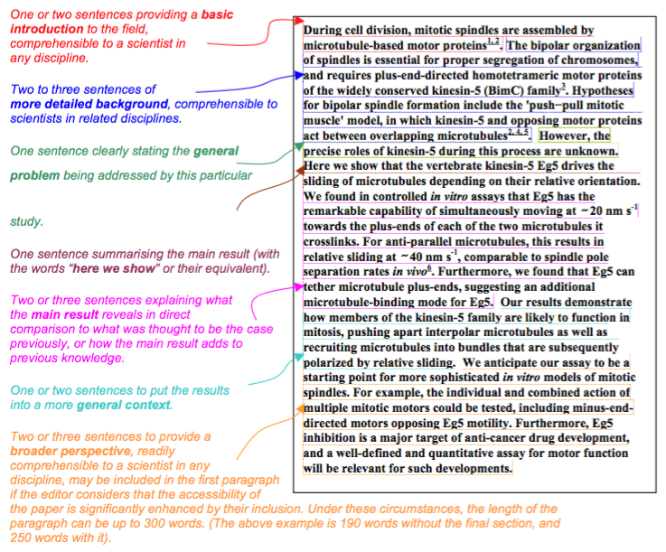
The Abstract – template by Nature
https://cbs.umn.edu/sites/cbs.umn.edu/files/public/downloads/Annotated_Nature_abstract.pdf

Slide 14
S02: Take home messages
Title + abstract: often the only freely accessible information. Need to be interesting + informative and motivate the reader to continue reading the whole paper
Brainstorming and explaining to others, getting feedback and reviewing your ideas are powerful steps that help writing well-structured, concise abstracts directed towards a specific target audience.
Abstract should provide answers to 4 questions:
Why did I start?
What did I do?
What did I find?
What does it mean?

Slide 15
S03xE01: Titles – the good, the bad, the ugly
Individually, select a journal and check out its table of content
Rate the titles based on your feeling whether they are good or bad
Select one good and one bad example

Slide 16
General considerations
Learning scientific writing is similar to learning a language
Concise, accurate, structured, non-redundant
Example: “Due to the fact of more run-off into the water, the end result is more bacteria in the water.”
Revision: “Higher levels of bacteria are caused by increased run-off.”
Avoid:
non-quantitative adjectives (many/lots, some, little, very)
ambiguous wording, grammar
“Using multiple-regression techniques, the animals in Experiment I …”
http://people.vetmed.wsu.edu/jmgay/courses/documents/ScientificWritingWordUsage.pdf

Slide 17
Improve clarity: 10 examples of cumbersome writing
Cluster of nouns
Clusters of adjectives
Subordinate clauses at beginning of sentence
Nouns derived from verbs
Filler verbs / words
Passive vs active
Use of imprecise words
Use of compound prepositions
Use of multiple negatives
Use of unfamiliar abbreviations, symbols and references
David Lindsay: A guide to scientific writing.

Slide 18
S03xE02: Power of position
Fleming, in 1929, discovered penicillin after a bacterial plate he was culturing became contaminated with a spore of the fungus Penicillium.
Re-order the sentence in as many ways as possible to put emphasis on different aspects.

Slide 19
S03xE03: Editing for readability – style guide
Using the readability guide, scan the manuscript:
http://www.pnas.org/content/114/36/9623.full
and identify cumbersome expressions. Re-phrase these according to the style guide and if possible use power of position to improve clarity.

Slide 20
S03xE04: Figures – the good, the bad, the ugly
Individually, look up the figures of the same manuscript: http://www.pnas.org/content/114/36/9623.full
Take a look at the figures and captions and make suggestions, how they could be improved
Ten simple rules for better figures (paper): https://journals.plos.org/ploscompbiol/article?id=10.1371/journal.pcbi.1003833

Slide 21
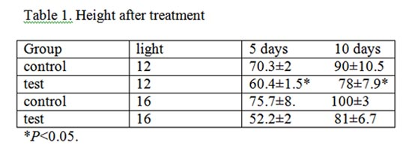
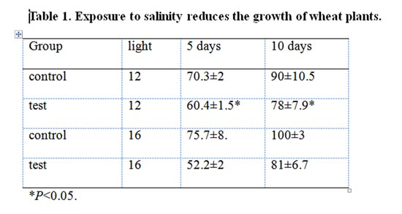
Tables
Use clear and informative titles

Slide 22
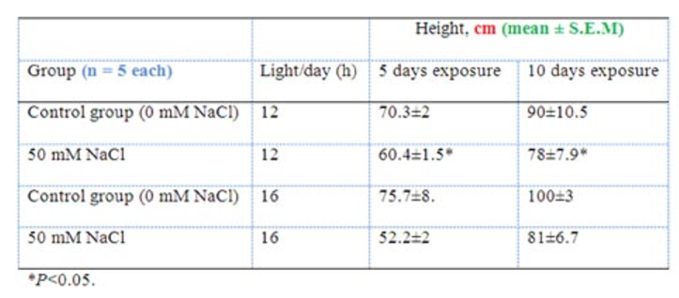
Tables
Use informative row and column titles, units, error values and sample sizes
Table 1. Exposure to salinity reduces the growth of wheat plants

Slide 23
S03: Take home messages
Convey a message in the title, figure captions and table headers
It is relatively easy to fix some stylistic mistakes following a few simple rules
Power of position: order sentences so that most important point is at the beginning

Slide 24
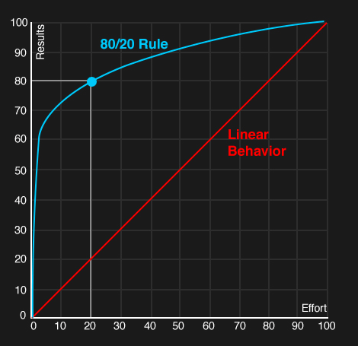
Time management & Pareto
The Pareto principle
David Lindsay: A guide to scientific writing.

Slide 25
Perspective of others
Try as hard as possible to read your report/manuscript as if you were an uninformed first-time reader
Have your manuscript read by an colleague / someone unfamiliar with the details of the work

Slide 26
S04: Take home messages
Set goals with time lines, meet them.If you do not meet them, revise accordingly.
Eisenhower matrix + Pareto can be helpful to manage your time.

Slide 27
Summary day 1
Be aware about the form and function of TAIMRD
Divide work into chunks and set deadlines, manage your time
Brainstorm & sort; bullet points first, then write
Revise after your write, not while you write
Being an active reader will make you a better writer
Know what readers expect and fill that expectation
Pay attention to mistakes when reading papers
During revision, check for structural, logic and stylistic mistakes
Check “rules”, use power of position, …
Get feedback and revise

Slide 28
Targeting audience / cover letter
S05xE01: Read abstract of Helfrich et al. 2018; highlight expressions, terminology, etc. that may be difficult to understand for a layperson. Next, read the corresponding press release and compare the language used (definitions, jargon, etc.), and identify what has been paraphrased.
S05xE02: Cover letter writing: target the editor as a reader (between layperson and field-specific expert). Draft a cover letter for the editor of the journal in which your would like to see your work published. Your aim is to convince him/her about the novelty and significance of your work and why this is interesting for the readership of the journal.

Slide 29
Resources
“A guide to scientific writing”, David Lindsay (basic)
“Style”, Joseph M. Williams (advanced)
Course material:
http://sunagawalab.ethz.ch/MIM_ScientificWriting/HS-2018
Rich online resource for scientific writing:
https://www.aje.com/en/arc/

Slide 30
Assignment
Research report due on 19. September 2018
max. 1500 words, 1 fig and/or 1 table.
TAIRD (MM if needed)
include citations, but no bibliography needed
You will receive your certificate upon receipt of report

Slide 31
Feedback
What was not very useful to me?
What was missing?
Would you recommend this course to others?

